Slide 1
STATE VARIABLE
Speed of a wave
v

Slide 2
STATE VARIABLE
Energy of a photon
E_{photon}

Slide 3
STATE VARIABLE
Index of refraction
n

Slide 4
STATE VARIABLE
Period of Wave
T

Slide 5
STATE VARIABLE
wavelength
λ

Slide 6
STATE VARIABLE
mass
m

Slide 7
STATE VARIABLE
Electric Field Strength
E

Slide 8
STATE VARIABLE
Potential Difference
V

Slide 9
STATE VARIABLE
Current
I

Slide 10
STATE VARIABLE
Cross-sectional area of a wire
A

Slide 11
STATE VARIABLE
Planck’s constant
h

Slide 12
STATE VARIABLE
Length of a conductor
L

Slide 13
STATE VARIABLE
Resistivity
ρ

Slide 14
STATE VARIABLE
Electrostatic constant
k

Slide 15
STATE VARIABLE
Electrical energy
W

Slide 16
STATE VARIABLE
momentum
p

Slide 17
STATE VARIABLE
Impulse
J

Slide 18
STATE VARIABLE
Power
P

Slide 19
STATE VARIABLE
Potential Energy
PE

Slide 20
STATE VARIABLE
Work
W

Slide 21
STATE VARIABLE
Universal Gravitational
G

Slide 22
STATE VARIABLE
Spring constant
k

Slide 23
STATE VARIABLE
Centripetal Force
F_{c}

Slide 24
STATE VARIABLE
Total Mechanical Energy
E_{T}

Slide 25
STATE VARIABLE
Force
F

Slide 26
STATE VARIABLE
Weight
F_{g}

Slide 27
STATE VARIABLE
Normal force
F_{N}

Slide 28
STATE VARIABLE
Net Force
F_{net}

Slide 29
STATE VARIABLE
Displacement or distance
d

Slide 30
STATE VARIABLE
height
h or d_{y}

Slide 31
STATE VARIABLE
charge
q

Slide 32
STATE VARIABLE
time
t

Slide 33
STATE VARIABLE
Coefficient of static friction
μ

Slide 34
STATE VARIABLE
Kinetic Energy
KE

Slide 35
STATE VARIABLE
Internal Energy
Q

Slide 36
STATE VARIABLE
Distance between centers
r

Slide 37
STATE VARIABLE
Electrostatic force
F_{e}

Slide 38
STATE VARIABLE
Gravitational field strength
g

Slide 39
STATE VARIABLE
Acceleration
a

Slide 40
STATE VARIABLE
Initial vertical velocity
v_{iy}

Slide 41
STATE VARIABLE
Final vertical velocity
v_{fy}

Slide 42
STATE VARIABLE
Average speed or velocity
v

Slide 43
STATE VARIABLE
Change in equilibrium length of a spring
x

Slide 44
STATE VARIABLE
Centripetal acceleration
a_{c}

Slide 45
STATE VARIABLE
Change in equilibrium length of a spring
x

Slide 46
STATE THE UNIT
Period of Wave
Seconds

Slide 47
STATE THE UNIT
Spring constant
N/m

Slide 48
STATE THE UNIT
Gravitational field strength
N/kg

Slide 49
STATE THE UNIT
Acceleration due to gravity
m/s²

Slide 50
STATE THE UNIT
wavelength
m

Slide 51
STATE THE UNIT
angle
degrees

Slide 52
STATE THE UNIT
Current
Amperes or C/s

Slide 53
STATE THE UNIT
Potential difference
V

Slide 54
STATE THE UNIT
charge
C or e

Slide 55
STATE THE UNIT
Energy of a photon
eV or J

Slide 56
STATE THE UNIT
Mass of proton
kg or u

Slide 57
STATE THE UNIT
Index of refraction
No units

Slide 58
STATE THE UNIT
Coefficient of friction
No unit

Slide 59
STATE THE UNIT
Impulse
Ns

Slide 60
STATE THE UNIT
Net force
N or kgm/s²

Slide 61
STATE THE UNIT
Work
Nm or J

Slide 62
STATE THE UNIT
Frequency
Hz

Slide 63
STATE THE UNIT
Kinetic Energy
J or kg(m²/s²)

Slide 64
STATE THE UNIT
Cross sectional area of a wire
m²

Slide 65
STATE THE UNIT
Power
Watts (W) or J/s

Slide 66
STATE THE UNIT
Total mechanical energy
J

Slide 67
STATE THE UNIT
Acceleration
m/s²

Slide 68
STATE THE UNIT
mass
kg

Slide 69
STATE THE UNIT
Weight
N

Slide 70
STATE THE UNIT
Speed of light
m/s

Slide 71
STATE THE UNIT
Resistance
Ω or ohms

Slide 72
STATE THE UNIT
Force on spring
N

Slide 73
STATE THE UNIT
Centripetal acceleration
m/s²

Slide 74
STATE THE UNIT
Planck’s constant
Js

Slide 75
COMPLETE THE TRIANGLE
d
v
t

Slide 76
COMPLETE THE TRIANGLE
v
f
λ

Slide 77
COMPLETE THE TRIANGLE
F_{f}
µ
F_{N}

Slide 78
COMPLETE THE TRIANGLE
F_{g}
m
g

Slide 79
COMPLETE THE TRIANGLE
c
n
v

Slide 80
COMPLETE THE TRIANGLE
E_{photon}
h
f

Slide 81
COMPLETE THE TRIANGLE
q
I
t

Slide 82
COMPLETE THE TRIANGLE
F_{s}
k
x

Slide 83
COMPLETE THE TRIANGLE
V
I
R

Slide 84
COMPLETE THE TRIANGLE
p
m
v

Slide 85
COMPLETE THE TRIANGLE
J
F
t

Slide 86
COMPLETE THE TRIANGLE
W
P
t

Slide 87
COMPLETE THE TRIANGLE
P
V
I

Slide 88
Equations to memorize
For an inclined plane, F_{N} is equal to
F_{g┴}=F_{g}cosθ=mg(cosθ)

Slide 89
Equations to memorize
For an inclined plane, F_{gII} is equal to
F_{gII}=F_{g}sinθ=mg(sinθ)

Slide 90
Equations to memorize
For a force applied at an angle, the horizontal (or force parallel to the surface) equals
F_{AX}=F_{A}cosθ

Slide 91
Equations to memorize
The equation for the area of a circle
A=πr²

Slide 92
Equations to memorize
The equation for the circumference of a circle
C=2πr

Slide 93
Equations to memorize
Initial vertical velocity of a projectile launched at an angle
v_{iy}=v_{i}sinθ

Slide 94
Equations to memorize
Initial horizontal velocity of a projectile launched at an angle
v_{ix}=v_{i}cosθ

Slide 95

Equations to memorize
Equation for centripetal force (combined version not on Ref Table)
F_{c}=$\frac{mv^{2}}{r}$

Slide 96
Equations to memorize
Equation for change in momentum = impulse (long version of Newton’s Second Law)
F_{net}t=mΔv

Slide 97
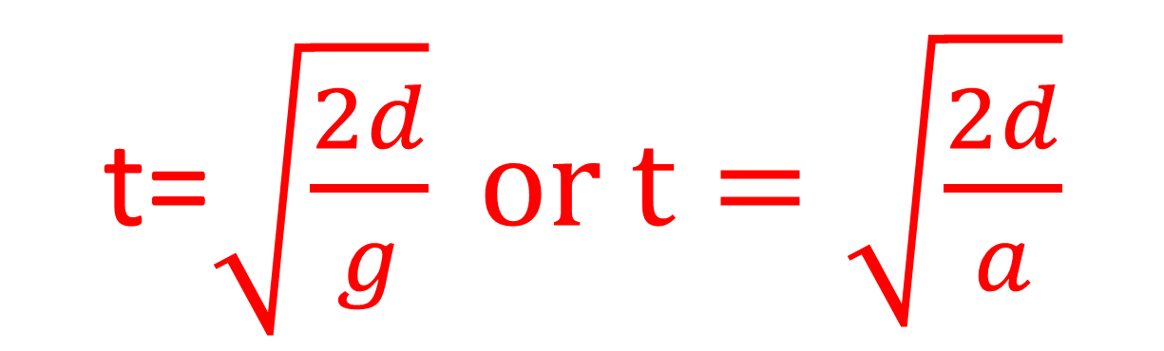
Equations to memorize
Short cut for time when v_{i}=0 such as dropped from rest
t=$\sqrt{\frac{2d}{g}} or t=\sqrt{\frac{2d}{a}}$

Slide 98
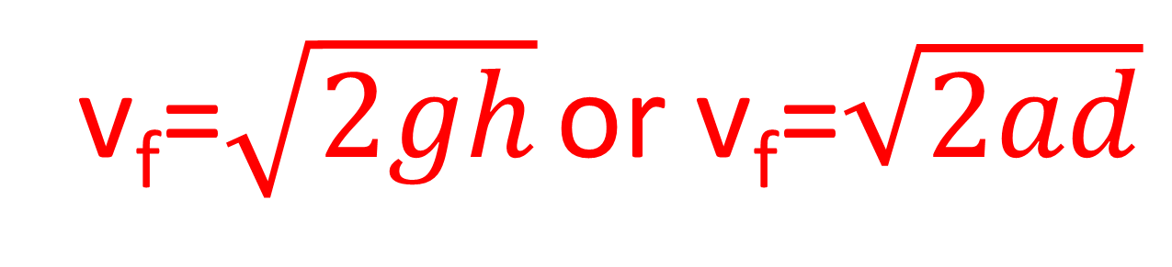
Equations to memorize
Short cut for final velocity when v_{i}=0
v_{f}=$\sqrt{2gh}$ or v_{f}=$\sqrt{2ad}$

Slide 99
Equations to memorize
Angle of a resultant given horizontal and vertical components
Θ=tan⁻¹(A_{y}/A_{x})

Slide 100
Equations to memorize
Equation for slope
Slope = (Δy/Δx)

Slide 101
Equations to memorize
Equation for area of a sloped (triangle) graph
Area = 1/2bh or
[(x-value)(y-value)]/2

Slide 102
Equations to memorize
Equation for area of a straight line (rectangular) graph
Area = bh or
(x-value)(y-value)

Slide 103
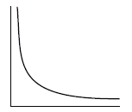
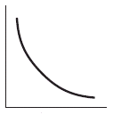
Name the type of relationship represented by the graph
Inverse or inverse square

Slide 104
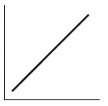
Name the type of relationship represented by the graph
Direct

Slide 105
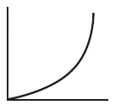
Name the type of relationship represented by the graph
Direct Square

Slide 106
Vocabulary or concept
A quantity in which both direction and magnitude are important
Vector

Slide 107
Vocabulary or Concept
A wave that requires a medium
Mechanical wave

Slide 108
Vocabulary or Concept
A wave in which particle vibration is perpendicular to wave propagation.
Transverse wave

Slide 109
Vocabulary or Concept
A wave in which particle vibration is parallel to wave propagation
Longitudinal

Slide 110
Vocabulary or Concept
Another word for mass
Inertia

Slide 111
Vocabulary or Concept
Mass x velocity =
Momentum or impulse

Slide 112
Vocabulary or Concept
The area where an object feels the force of another object with the same fundamental force carrier
Field

Slide 113
Vocabulary or Concept
The rate of energy or work
Power

Slide 114
Vocabulary or Concept
Horizontal distance traveled by a projectile
Range

Slide 115
Vocabulary or Concept
The word for the “size” of a measurement
Magnitude

Slide 116
Vocabulary or Concept
Term for the sum of two vector quantities
Resultant

Slide 117
Vocabulary or Concept
The term for an object that is not experiencing acceleration
Constant velocity or equilibrium

Slide 118
Vocabulary or Concept
Force x distance =
Work

Slide 119
Vocabulary or Concept
Term for energy that builds up due to friction
Internal energy

Slide 120
Vocabulary or Concept
The energy gained when an object is lifted in a gravitational field
Potential energy

Slide 121
Vocabulary or Concept
Energy associated with motion
Kinetic Energy

Slide 122
Vocabulary or Concept
The quark composition of a neutron
udd

Slide 123
Vocabulary or Concept
Quark composition of a proton
uud

Slide 124
Vocabulary or Concept
The event that occurs when a particle of matter meets with the corresponding antimatter
annihilation

Slide 125
Vocabulary or Concept
The number of cycles per second for a wave
Frequency

Slide 126
Vocabulary or Concept
Seconds per cycle for a wave
Period

Slide 127
Vocabulary or Concept
When a wave in the environment causes an object to vibrate due to matching frequency
Resonance

Slide 128
Vocabulary or Concept
Meters per cycle for a wave
wavelength

Slide 129
Vocabulary or Concept
The height of a wave above the equilibrium line (or depth below)
Amplitude

Slide 130
Vocabulary or Concept
Amount of charge that flows per second
Current

Slide 131
Vocabulary or Concept
The amount of energy (or work done) on each charge
Potential difference

Slide 132
Vocabulary or Concept
A circuit in which electrons have a choice of paths
Parallel Circuit

Slide 133
Vocabulary or Concept
A circuit in which electrons all follow the same path
Series circuit

Slide 134
Vocabulary or Concept
A device to measure current
Ammeter

Slide 135
Vocabulary or Concept
A device to measure potential difference
voltmeter

Slide 136
Vocabulary or Concept
The difficulty and electron has in completing a circuit
Resistance

Slide 137
Vocabulary or Concept
The ratio of a waves speed in a vacuum to a waves speed in a material
Absolute index of refraction

Slide 138
Vocabulary or Concept
The type of wave that can travel through a vacuum
Electromagnetic wave

Slide 139
Vocabulary or Concept
A single vibratory disturbance in a medium
pulse

Slide 140
Vocabulary or Concept
The force that holds the nucleus together (acts between neutrons and protons)
Strong force

Slide 141
Vocabulary or Concept
Force that acts between an electron and a proton
Electromagnetic force

Slide 142
Vocabulary or Concept
Truly empty space
vacuum

Slide 143
Vocabulary or Concept
The force carrier (boson) of the electromagnetic force
photon

Slide 144
Vocabulary or Concept
Measure of energy when working with small charges such as an electron or other elementary charge
Electronvolt eV

Slide 145
Vocabulary or Concept
The bending of a wave around an obstruction or through an opening in a barrier
diffraction

Slide 146
Vocabulary or Concept
Measure of energy when working with small charges such as an electron.
Electronvolt eV

Slide 147
Vocabulary or Concept
The bending of a wave into a new medium when it is transmitted.
refraction

Slide 148
Vocabulary or Concept
The change in observed frequency of a wave due to the relative motion of the source and the observer.
Doppler Effect

Slide 149
Vocabulary or Concept
When two waves are in the same place at the same time and they superimpose temporarily to form a supercrest or supertrough
Constructive interference

Slide 150
Vocabulary or Concept
When two waves are in the same place at the same time and they superimpose temporarily to cancel each other out.
Destructive interference

Slide 151
Vocabulary or Concept
A wave that is formed due to reflection off a boundary and forms a pattern of interference which leads to nodes and antinodes
Standing Wave

Slide 152
Vocabulary or Concept
The name given to the angle from the normal line as it approaches a boundary between two mediums
Incident Angle

Slide 153
Vocabulary or Concept
When light or other transverse wave can be filtered for a specific orientation
Polarization

Slide 154
Vocabulary or Concept
When light is given off by an atom as electrons fall between energy levels
emission

Slide 155
Vocabulary or Concept
The low point on a wave
trough

Slide 156
Vocabulary or Concept
The high point on a wave
crest

Slide 157
Vocabulary or Concept
The bouncing of a wave off of a surface at an angle equal to the incident angle
Reflection

Slide 158
Vocabulary or Concept
A change in speed or direction of an object with respect to time
acceleration

Slide 159
Vocabulary or Concept
A particle made up of three quarks.
Baryon

Slide 160
Vocabulary or Concept
The force which causes an object to follow a circular path.
Centripetal force

Slide 161
Vocabulary or Concept
A material which allows electrons to flow easily (lots of free electrons)
Conductor

Slide 162
Vocabulary or Concept
The base unit for electric charge of a particle.
Coulomb

Slide 163
Vocabulary or Concept
The point on a standing wave that undergoes constructive interference
Anti-node

Slide 164
Vocabulary or Concept
The term for discrete (non-continuous) energy levels with an atom
quantized

