Slide 1
Equations to memorize
For an inclined plane, F_{N} is equal to
F_{g┴}=F_{g}cosθ=mg(cosθ)

Slide 2
Equations to memorize
For an inclined plane, F_{gII} is equal to
F_{gII}=F_{g}sinθ=mg(sinθ)

Slide 3
Equations to memorize
For a force applied at an angle, the horizontal (or force parallel to the surface) equals
F_{AX}=F_{A}cosθ

Slide 4
Equations to memorize
The equation for the area of a circle
A=πr²

Slide 5
Equations to memorize
The equation for the circumference of a circle (use as distance in v=d/t for a circular path)
C=2πr

Slide 6
Equations to memorize
Initial vertical velocity of a projectile launched at an angle
v_{iy}=v_{i}sinθ

Slide 7
Equations to memorize
Initial horizontal velocity of a projectile launched at an angle
v_{ix}=v_{i}cosθ

Slide 8
Equations to memorize
Equation for centripetal force (combined version not on Ref Table)
F_{c}=$\frac{mv^{2}}{r}$

Slide 9
Equations to memorize
Equation for change in momentum = impulse (long version of Newton’s Second Law)
F_{net}t=mΔv

Slide 10
Equations to memorize
Short cut for time when v_{i}=0 such as dropped from rest
t=$\sqrt{\frac{2d}{g}} or t=\sqrt{\frac{2d}{a}}$

Slide 11
Equations to memorize
Short cut for final velocity when v_{i}=0
v_{f}=$\sqrt{2gh}$ or v_{f}=$\sqrt{2ad}$

Slide 12
Equations to memorize
Angle of a resultant given horizontal and vertical components
Θ=tan⁻¹(A_{y}/A_{x})

Slide 13
Equations to memorize
Equation for slope
Slope = (Δy/Δx)

Slide 14
Equations to memorize
Equation for area of a sloped (triangle) graph
Area = 1/2bh or
[(x-value)(y-value)]/2

Slide 15
Equations to memorize
Equation for area of a straight line (rectangular) graph
Area = bh or
(x-value)(y-value)

Slide 16
Equations to memorize
Equation for cross-sectional area of a wire
Area =πr²

Slide 17
Name the type of relationship represented by the graph
Inverse or inverse square y=m/x or y=m/x²

Slide 18
Name the type of relationship represented by the graph
Direct y=mx

Slide 19
Name the type of relationship represented by the graph
Direct Square
y=mx²

Slide 20
Vocabulary or concept
A quantity in which both direction and magnitude are important
Vector

Slide 21
Vocabulary or concept
The vertical speed of a projectile at the highest point in the path
v = 0

Slide 22
Vocabulary or concept
A constant (uniform) net force acting on an object means that acceleration will be
Constant or uniform

Slide 23
Vocabulary or concept
A constant (uniform) net force acting on an object means that velocity of the object will be
Changing

Slide 24
Vocabulary or concept
The vertical acceleration of a projectile at the highest point in the path
a = 9.81m/s² downward

Slide 25
Vocabulary or concept
The equation needed for the horizontal axis of projectile’s motion
v=d/t
(acceleration = 0)

Slide 26
Vocabulary or concept
The horizontal acceleration of a projectile is always
a = 0

Slide 27
Vocabulary or Concept
A wave that requires a medium
Mechanical wave

Slide 28
Vocabulary or Concept
A wave in which particle vibration is perpendicular to wave propagation.
Transverse wave

Slide 29
Vocabulary or Concept
A wave in which particle vibration is parallel to wave propagation
Longitudinal

Slide 30
Vocabulary or Concept
Another word for mass
Inertia

Slide 31
Vocabulary or Concept
An object’s resistance to change in motion.
Inertia

Slide 32
Vocabulary or Concept
Mass x velocity =
Momentum or impulse

Slide 33
Vocabulary or Concept
The area where an object feels the force of another object with the same fundamental force carrier
Field

Slide 34
Vocabulary or Concept
The rate of energy or work
Power

Slide 35
Vocabulary or Concept
Horizontal distance traveled by a projectile
Range

Slide 36
Vocabulary or Concept
An object that only experiences the force of gravity. (F_{net}=F_{g})
Projectile

Slide 37
Vocabulary or Concept
The word for the “size” of a measurement
Magnitude

Slide 38
Vocabulary or Concept
Term for the sum of two vector quantities
Resultant

Slide 39
Vocabulary or Concept
For an object in an elevator the apparent weight of the object due to the push of the floor is equal to the
Normal force

Slide 40
Vocabulary or Concept
The term for an object that is not experiencing acceleration
Constant velocity or equilibrium

Slide 41
Vocabulary or Concept
Force x distance =
Work

Slide 42
Vocabulary or Concept
Term for energy that builds up due to friction
Internal energy

Slide 43
Vocabulary or Concept
The energy gained when an object is lifted in a gravitational field (Energy related to vertical position)
Potential energy

Slide 44
Vocabulary or Concept
Energy associated with motion
Kinetic Energy

Slide 45
Vocabulary or Concept
The quark composition of a neutron
udd

Slide 46
Vocabulary or Concept
Quark composition of a proton
uud

Slide 47
Vocabulary or Concept
The event that occurs when a particle of matter meets with the corresponding antimatter
annihilation

Slide 48
Vocabulary or Concept
Characteristics of a wave that does not change when encountering a new material
frequency

Slide 49
Vocabulary or Concept
Characteristics of an EM wave that is associated with energy
frequency

Slide 50
Vocabulary or Concept
Characteristic of a mechanical wave associated with energy
Amplitude

Slide 51
Vocabulary or Concept
The number of cycles per second for a wave
Frequency

Slide 52
Vocabulary or Concept
Seconds per cycle for a wave
Period

Slide 53
Vocabulary or Concept
When a wave in the environment causes an object to vibrate due to matching frequency
Resonance

Slide 54
Vocabulary or Concept
Meters per cycle for a wave
wavelength

Slide 55
Vocabulary or Concept
The height of a wave above the equilibrium line (or depth below)
Amplitude

Slide 56
Vocabulary or Concept
For an object in free fall, the total mechanical energy of the object
Remains the same

Slide 57
Vocabulary or Concept
Amount of charge that flows per second
Current

Slide 58
Vocabulary or Concept
The amount of energy (or work done) on each charge as it moves through a circuit component
Potential difference

Slide 59
Vocabulary or Concept
A circuit in which electrons have a choice of paths
Parallel Circuit

Slide 60
Vocabulary or Concept
A circuit in which electrons all follow the same path
Series circuit

Slide 61
Vocabulary or Concept
A device to measure current
Ammeter

Slide 62
Vocabulary or Concept
A device to measure potential difference
voltmeter

Slide 63
Vocabulary or Concept
The difficulty and electron has in completing a circuit
Resistance

Slide 64
Vocabulary or Concept
The ratio of a waves speed in a vacuum to a waves speed in a material
Absolute index of refraction

Slide 65
Vocabulary or Concept
The type of wave that can travel through a vacuum
Electromagnetic wave

Slide 66
Vocabulary or Concept
A single vibratory disturbance in a medium
pulse

Slide 67
Vocabulary or Concept
The force that holds the nucleus together (acts between neutrons and protons or “quark matter”
Strong force

Slide 68
Vocabulary or Concept
Force that acts between an electron and a proton
Electromagnetic force

Slide 69
Vocabulary or Concept
Truly empty space
vacuum

Slide 70
Vocabulary or Concept
The force carrier (boson) of the electromagnetic force
photon

Slide 71
Vocabulary or Concept
Measure of energy when working with small charges such as an electron or other elementary charge
Electronvolt eV

Slide 72
Vocabulary or Concept
The bending of a wave around an obstruction or through an opening in a barrier
diffraction

Slide 73
Vocabulary or Concept
Measure of energy when working with small charges such as an electron.
Electronvolt eV

Slide 74
Vocabulary or Concept
The bending of a wave into a new medium when it is transmitted.
refraction

Slide 75
Vocabulary or Concept
When a sound wave moves from air into water the speed...
increases

Slide 76
Vocabulary or Concept
When an EM wave moves from air into water, the speed of the wave
decreases

Slide 77
Vocabulary or Concept
The change in observed frequency of a wave due to the relative motion of the source and the observer.
Doppler Effect

Slide 78
Vocabulary or Concept
When two waves are in the same place at the same time and they superimpose temporarily to form a supercrest or supertrough
Constructive interference

Slide 79
Vocabulary or Concept
When two waves are in the same place at the same time and they superimpose temporarily to cancel each other out.
Destructive interference

Slide 80
Vocabulary or Concept
A wave that is formed due to reflection off a boundary and forms a pattern of interference which leads to nodes and antinodes
Standing Wave

Slide 81
Vocabulary or Concept
The name given to the angle from the normal line as it approaches a boundary between two mediums
Incident Angle

Slide 82
Vocabulary or Concept
When light or other transverse wave can be filtered for a specific orientation
Polarization

Slide 83
Vocabulary or Concept
When light is given off by an atom as electrons fall between energy levels
emission

Slide 84
Vocabulary or Concept
The low point on a wave
trough

Slide 85
Vocabulary or Concept
The high point on a wave
crest

Slide 86
Vocabulary or Concept
The bouncing of a wave off of a surface at an angle equal to the incident angle
Reflection

Slide 87
Vocabulary or Concept
A change in speed or direction of an object with respect to time
acceleration

Slide 88
Vocabulary or Concept
A particle made up of three quarks.
Baryon

Slide 89
Vocabulary or Concept
Net force which causes an object to follow a circular path.
Centripetal force

Slide 90
Vocabulary or Concept
For an object moving in a circular path, net force (centripetal force) and acceleration vectors are always
Directed to the center of the circle

Slide 91
Vocabulary or Concept
For an object moving in a circular path, the velocity vector is always
Tangent to the circle

Slide 92
Vocabulary or Concept
A material which allows electrons to flow easily (lots of free electrons)
Conductor

Slide 93
Vocabulary or Concept
The equivalent resistance of a parallel circuit is equal to
The inverse of the sum of the inverses

Slide 94
Vocabulary or Concept
The base unit for electric charge of a particle.
Coulomb

Slide 95
Vocabulary or Concept
The point on a standing wave that undergoes constructive interference
Anti-node

Slide 96
Vocabulary or Concept
The term for discrete (non-continuous) energy levels within an atom
quantized

Slide 97
Vocabulary or Concept
In order for a charged particle to have a magnetic field the charge must be
moving

Slide 98
Vocabulary or Concept
In order for a charged particle to create an EM wave (photon) the charged particle must be
Accelerating or oscillating

Slide 99
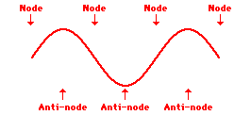
Image to recognize
Standing Wave

Slide 100
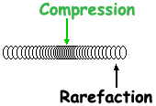
Image to recognize
Longitudinal Wave

Slide 101
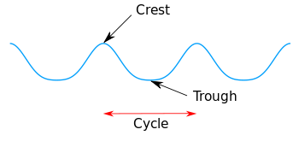
Image to recognize
Transverse Wave

Slide 102
Image to recognize
Doppler Effect

Slide 103
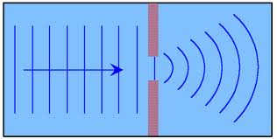
Image to recognize
Diffraction

Slide 104
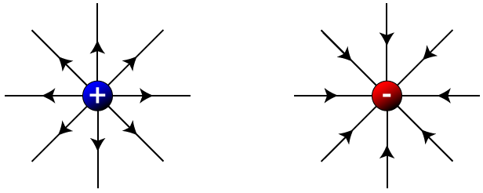
Image to recognize
Electric Field Lines (away from positive and toward negative)

Slide 105
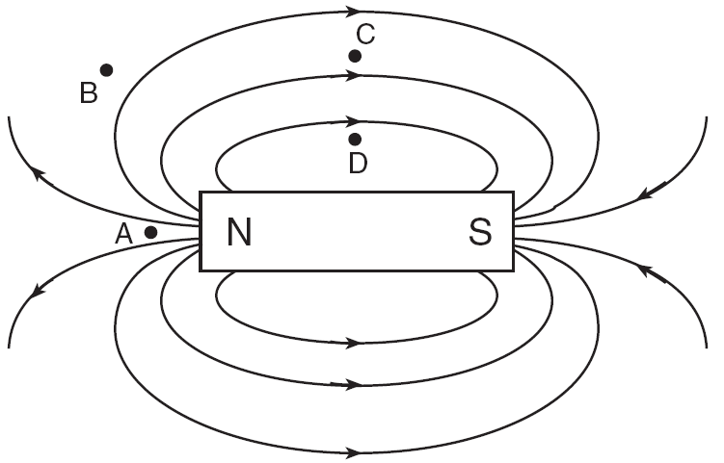
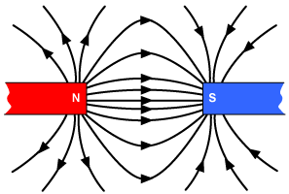
Image to recognize
Magnetic field lines

Slide 106
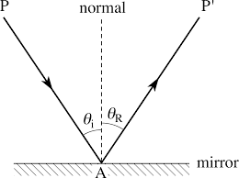
Image to recognize
Reflection

Slide 107
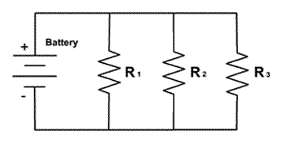
Image to recognize
Parallel Circuit

Slide 108
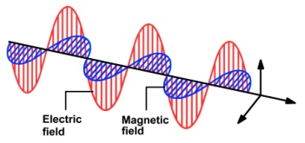
Image to recognize
Electromagnetic wave

Slide 109
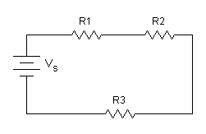
Image to recognize
Series Circuit

Slide 110
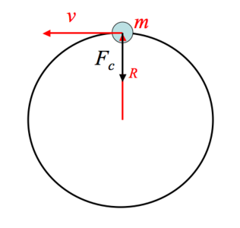
Image to recognize
-Velocity is tangent
-Centripetal Force &Centripetal Acceleration are toward center

Slide 111
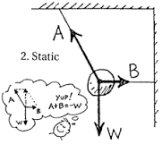
Image to recognize
W is the equilibrant

Slide 112
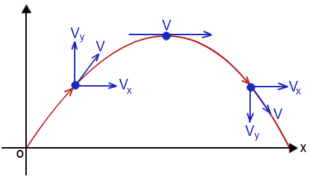
Image to recognize
Path of a Projectile launched at an angle

Slide 113
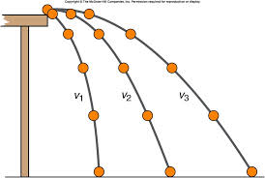
Image to recognize
Horizontal Projectile

Slide 114
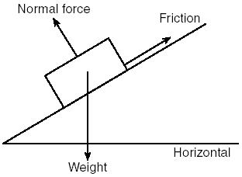
Image to recognize
Inclined Plane
Weight (Fg)
Normal Force (Fgperp)
Parallel Force (Fg parallel)

Slide 115
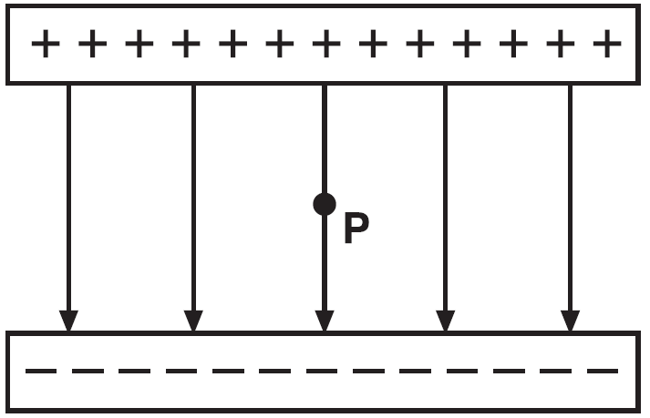
Image to recognize
Parallel Plate

Slide 116
Mathematical Skill
To convert from elementary charge to Coulombs…..
Multiply by 1.6 x 10⁻¹⁹C

Slide 117
Mathematical Skill
To convert from Coulombs to elementary charge…..
Divide by 1.6 x 10⁻¹⁹C

Slide 118
Mathematical Skill
To convert from eV’s to Joules…..
Multiply by 1.6 x 10⁻¹⁹J

Slide 119
Mathematical Skill
To convert from Joules to eV’s …..
Divide by 1.6 x 10⁻¹⁹J

Slide 120
Mathematical Skill
To convert from universal mass units to MeV’s
Multiply by 9.31 x 10²MeV

Slide 121
Mathematical Skill
To find work done on a spring or energy stored in a spring…
Find the area of F_{s} vs x using 1/2bh or (1/2F_{s})(x)

Slide 122
Mathematical Skill
To find velocity from a d vs t graph use
slope

Slide 123
Mathematical Skill
To find distance from a velocity vs time graph use …
area

Slide 124
Mathematical Skill
To find acceleration from a velocity vs time graph use …
Slope

Slide 125
Mathematical Skill
To find work done on a spring or energy stored in a spring…
Find the area of F_{s} vs x using 1/2bh or (1/2F_{s})(x)

Slide 126
Mathematical Skill
To find work done on a spring or energy stored in a spring…
Find the area of F_{s} vs x using 1/2bh or (1/2F_{s})(x)

Slide 127
Mathematical Skill
To find work done on a spring or energy stored in a spring…
Find the area of F_{s} vs x using 1/2bh or (1/2F_{s})(x)

Slide 128
Mathematical Skill
To find work done on a spring or energy stored in a spring…
Find the area of F_{s} vs x using 1/2bh or (1/2F_{s})(x)

