Slide 1
STATE VARIABLE
Speed of a wave
v

Slide 2
STATE VARIABLE
Speed of light in a vacuum
c

Slide 3
STATE VARIABLE
Index of refraction
n

Slide 4
STATE VARIABLE
Period of Wave
T

Slide 5
STATE VARIABLE
wavelength
λ

Slide 6
STATE VARIABLE
Incident Angle
Θ_{i} or Θ₁

Slide 7
STATE VARIABLE
Angle of reflection
Θ_{r}

Slide 8
STATE VARIABLE
Refracted Angle
Θ₂

Slide 9
STATE VARIABLE
Energy of a photon
E_{photon}

Slide 10
STATE VARIABLE
Planck’s Constant
h

Slide 11
STATE VARIABLE
Energy
E

Slide 12
STATE VARIABLE
mass
m

Slide 13
STATE VARIABLE
Energy
E

Slide 14
STATE VARIABLE
Index of refraction for 1st medium
n₁

Slide 15
STATE VARIABLE
Index of refraction 2nd medium
n₂

Slide 16
STATE THE UNIT
Period of Wave
Seconds

Slide 17
STATE THE UNIT
wavelength
m

Slide 18
STATE THE UNIT
angle
degrees

Slide 19
STATE THE UNIT
Index of refraction
No units

Slide 20
STATE THE UNIT
Frequency
Hz

Slide 21
STATE THE UNIT
Speed of light
m/s

Slide 22
STATE THE UNIT
Planck’s Constant
Js

Slide 23
STATE THE UNIT
Energy of photon
J or eV

Slide 24
STATE THE UNIT
mass
kg

Slide 25
COMPLETE THE TRIANGLE
d
v
t

Slide 26
COMPLETE THE TRIANGLE
v
f
λ

Slide 27
COMPLETE THE TRIANGLE
c is a constant
c
n
v

Slide 28
COMPLETE THE TRIANGLE
h is a constant
E_{photon}
h
f

Slide 29
Equations to understand
Snell’s Law
n₁sinΘ₁=n₂sinΘ₂

Slide 30
Equations to understand
Equation used for the conversion of mass (kg) into energy (J)
(ie, Energy mass equivalence)
E=mc²

Slide 31
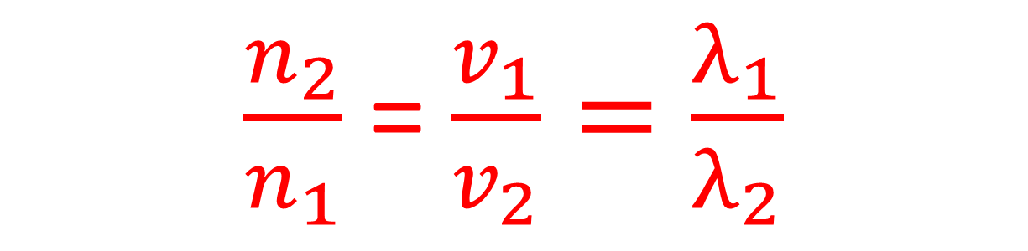
Equations to memorize
Relationship between index, wavelength and speed of a wave
(remember speed and wavelength are direct…..index of refraction is inverse to both)
$\frac{n_{2}}{n_{1}}$ = $\frac{v_{1}}{v_{2}}=\frac{λ_{1}}{λ_{2}}$

Slide 32
Equations to memorize
Equation for slope
Slope = (Δy/Δx)

Slide 33
Equations to memorize
To convert from universal mass units to Mega electronvolts
Multiply by 9.31 x 10² MeV

Slide 34
Equations (Skill) to memorize
To convert eV to Joules
Multiply by 1.6 x 10⁻¹⁹J

Slide 35
Equations (Skill) to memorize
To convert Joules to eV’s
Divide by 1.6 x 10⁻¹⁹J

Slide 36
Vocabulary or Concept
A wave that requires a medium
Mechanical wave

Slide 37
Vocabulary or Concept
A wave in which particle vibration is perpendicular to wave propagation.
Transverse wave

Slide 38
Vocabulary or Concept
Waves transfer _____________.
Energy (not mass)

Slide 39
Vocabulary or Concept
A wave in which particle vibration is parallel to wave propagation
Longitudinal

Slide 40
Vocabulary or Concept
The number of cycles per second for a wave
Frequency

Slide 41
Vocabulary or Concept
Seconds per cycle for a wave
Period

Slide 42
Vocabulary or Concept
When a wave in the environment causes an object to vibrate due to matching frequency
Resonance

Slide 43
Vocabulary or Concept
Meters per cycle for a wave
wavelength

Slide 44
Vocabulary or Concept
The height of a wave above the equilibrium line (or depth below)
Amplitude

Slide 45
Vocabulary or Concept
The ratio of a waves speed in a vacuum to a waves speed in a material
Absolute index of refraction

Slide 46
Vocabulary or Concept
The type of wave that can travel through a vacuum
Electromagnetic wave

Slide 47
Vocabulary or Concept
A single vibratory disturbance in a medium
pulse

Slide 48
Vocabulary or Concept
Truly empty space
vacuum

Slide 49
Vocabulary or Concept
The bending of a wave around an obstruction or through an opening in a barrier
diffraction

Slide 50
Vocabulary or Concept
The bending of a wave into a new medium when it is transmitted.
refraction

Slide 51
Vocabulary or Concept
The change in observed frequency of a wave due to the relative motion of the source and the observer.
Doppler Effect

Slide 52
Vocabulary or Concept
When two waves are in the same place at the same time and they superimpose temporarily to form a supercrest or supertrough
Constructive interference

Slide 53
Vocabulary or Concept
When two waves are in the same place at the same time and they superimpose temporarily to cancel each other out.
Destructive interference

Slide 54
Vocabulary or Concept
A wave that is formed due to reflection off a boundary and forms a pattern of interference which leads to nodes and antinodes
Standing Wave

Slide 55
Vocabulary or Concept
The name given to the angle from the normal line as it approaches a boundary between two mediums
Incident Angle

Slide 56
Vocabulary or Concept
When light or other transverse wave can be filtered for a specific orientation
Polarization

Slide 57
Vocabulary or Concept
The low point on a wave
trough

Slide 58
Vocabulary or Concept
The high point on a wave
crest

Slide 59
Vocabulary or Concept
The bouncing of a wave off of a surface at an angle equal to the incident angle
Reflection

Slide 60
Vocabulary or Concept
The point on a standing wave that undergoes constructive interference
Anti-node

Slide 61
Vocabulary or Concept
The point on a standing wave that undergoes destructive interference
node

Slide 62
Vocabulary or Concept
The phase difference between waves at a node
180 degrees

Slide 63
Vocabulary or Concept
The fundamental force that holds the nucleus together
Strong Force

Slide 64
Vocabulary or Concept
Fundamental force that causes a proton and an electron to attract
Electromagnetic force

Slide 65
Vocabulary or Concept
Phenomena experienced by light that support the wave theory
Diffraction and interference
(Double Slit Experiment)

Slide 66
Vocabulary or Concept
Fundamental force that causes masses to attract
Gravity

Slide 67
Vocabulary or Concept
Fundamental force responsible for radioactive decay
Weak force

Slide 68
Vocabulary or Concept
Name for the force carrier particles
Boson

Slide 69
Vocabulary or Concept
Phenomena experienced by light that support the particle theory
Photoelectric effect, reflection and refraction

Slide 70
Vocabulary or Concept
When a particle and a corresponding anti-particle meet they will
annihilate

Slide 71
Vocabulary or Concept
The line that is perpendicular to a boundary between two mediums at the point of intersection with a light ray
Normal line

Slide 72
Vocabulary or Concept
When an EM wave moves into a medium with a higher index of refraction, the speed of the wave
decreases

Slide 73
Vocabulary or Concept
If an object and an observer are moving apart the frequency of light will be shifted
red

Slide 74
Vocabulary or Concept
The relationship between two indices of refraction (n₁ and n₂) and the angle of incidence and angle of refraction is (Θ₁ and Θ₂) is
Inverse

Slide 75
Vocabulary or Concept
A charged particle that is accelerating (oscillating) creates an
Electromagnetic wave (photon)

Slide 76
Fact
The quark composition of a proton
uud

Slide 77
Fact
The quark composition of a neutron
udd

Slide 78
Fact
When a sound wave moves to a material that is more dense (gas to liquid or liquid to solid) the speed of the wave
increases

Slide 79
Fact
For refraction and reflection all angles (Θ_{i} Θ₁ Θ_{r} Θ₂) are measured between the light ray and the
Normal line

Slide 80
Fact
When a wave moves between mediums, the frequency of the wave
Remains the same

Slide 81
Fact
When a wave moves into a new medium and slows down, the angle to the normal line
decreases

Slide 82
Fact
The energy of a mechanical wave is associated with
Amplitude

Slide 83
Fact
The energy of an electromagnetic wave is related to
frequency

Slide 84
Fact
To determine the category of an EM wave on the EM Spectrum you must express wavelength or frequency in
proper scientific notation (in meters)

Slide 85
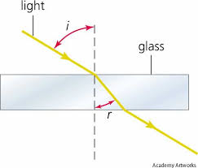
Recognizing image
Refraction

Slide 86
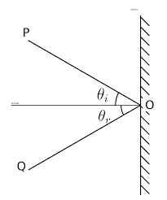
Recognizing image
Reflection

Slide 87
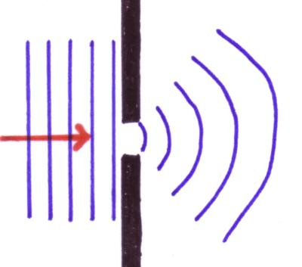
Recognizing image
Diffraction

Slide 88
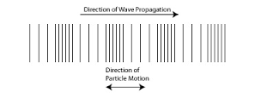
Recognizing image
Longitudinal wave

Slide 89
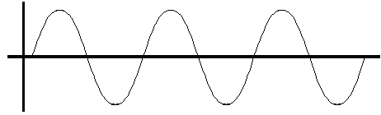
Recognizing image
Transverse wave

Slide 90
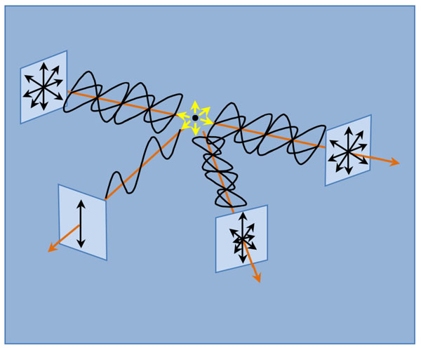
Recognizing image
Polarization

Slide 91
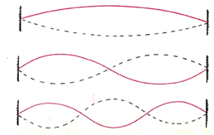
Recognizing image
Standing Wave

Slide 92
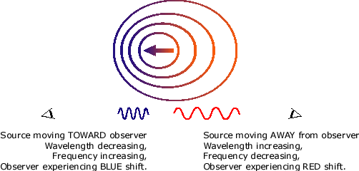
Recognizing image
Doppler Effect

