Slide 1
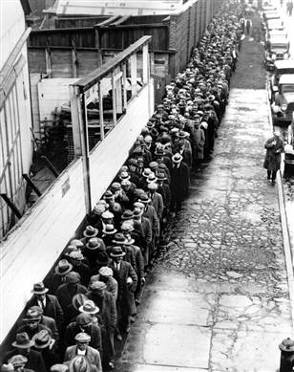
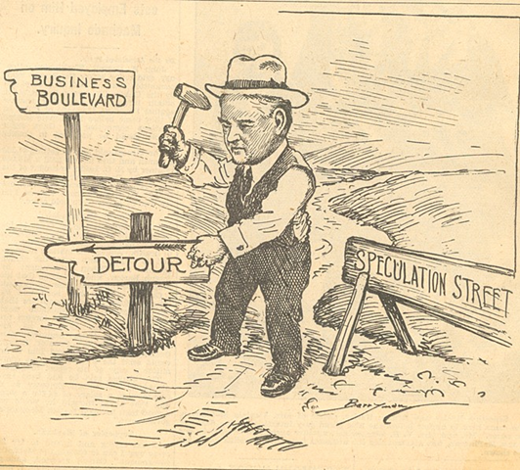
HOOVER AND THE CRASH 23-1

Slide 2
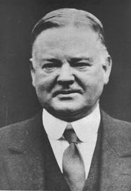
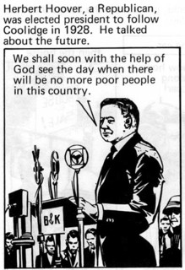
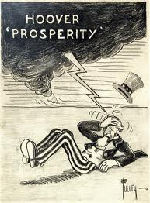
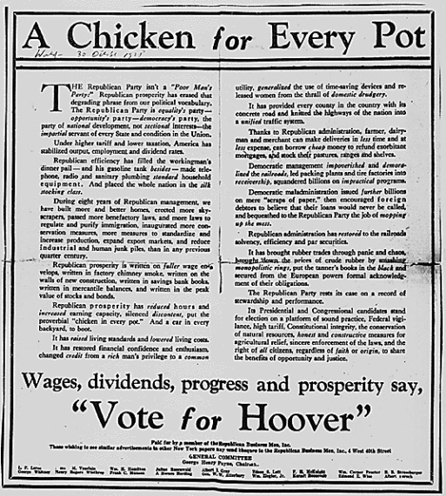
A COLLAPSING ECONOMY
In 1928, Herbert Hoover had predicted that the United States would soon achieve the “final triumph over poverty.”
In fact, the county was heading for the worst economic crisis in its history.

Slide 3
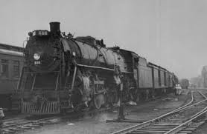
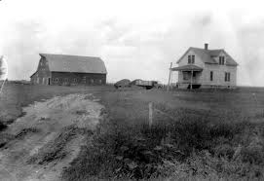
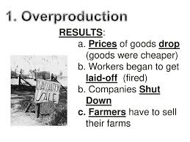
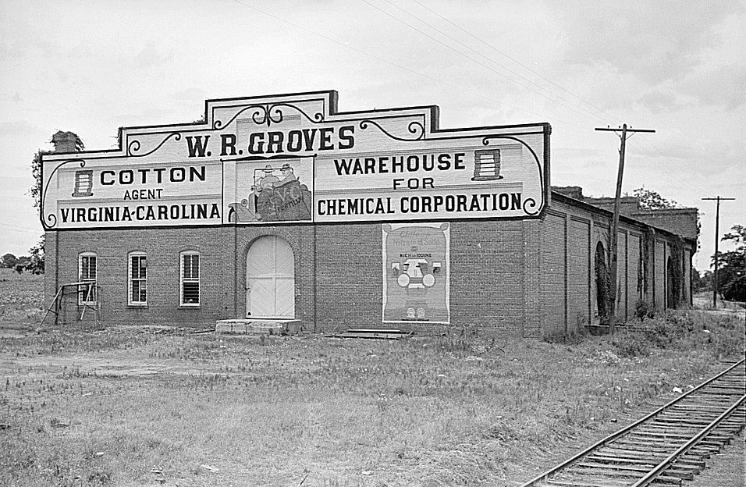
SIGNS OF WEAKNESS
Several signs of economic weakness surfaced during the late 1920s.
Older Industries, such as coal mining, railroads, and clothing manufacture, were in decline.
Agriculture was also experiencing a prolonged downturn.
Supply was greater than the demand.
OVERPRODUCTION

Slide 4
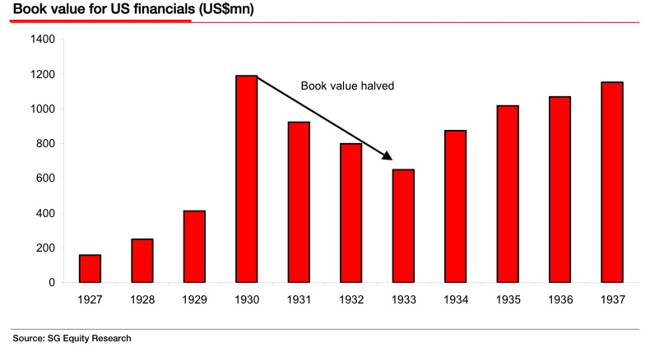
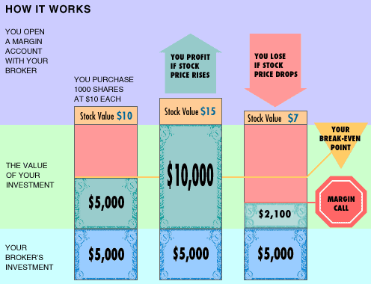
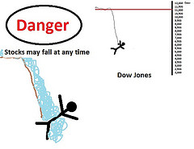
Something isn’t right
As sections of the economy declined, stock prices continued to soar.
Margin buying allowed people to purchase stocks by paying only a fraction of the cost at the outset and owing.
Margin buyers gambled that prices would be higher when they were ready to sell.

Slide 5
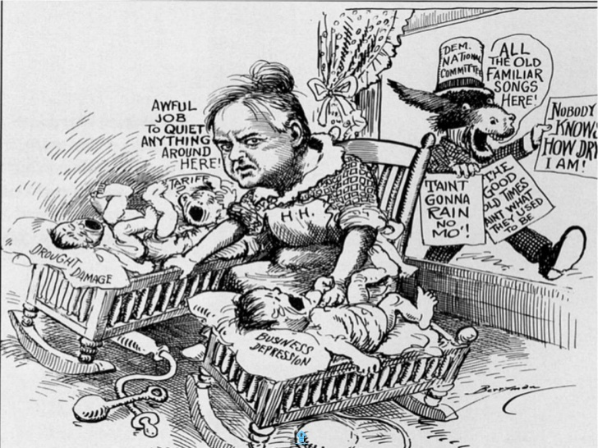

Slide 6
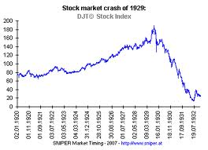
THE STOCK MARKET CRASHES
By September, 1929, prices for stock began a rapid DOWNWARD slide.
Brokers who had lent people money to buy on margin now began to recall their loans.
Recalling loans meant they buyers (Investors) were asked to pay back what they owed early.
Problem, they didn’t have the money.
Investors were forced to sell their stocks.
This caused prices to drop even more.

Slide 7
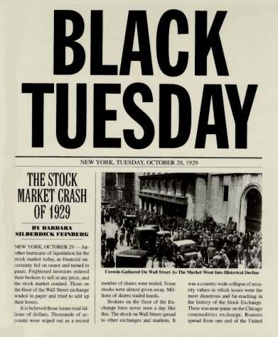
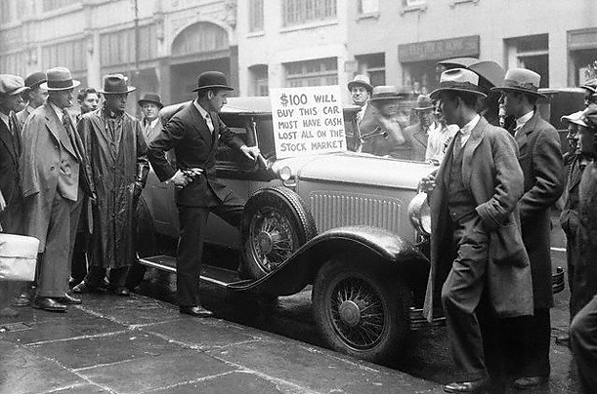
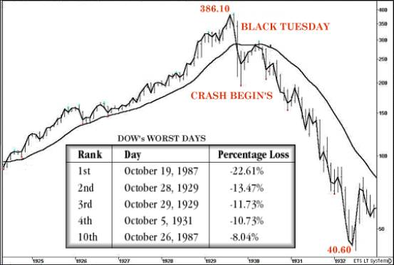
OCTOBER 29, 1929
10/29/1929 became known as “Black Tuesday.”
On this date the stock market crumbled.
Millionaires lost fortunes over night.
Over the next two weeks, stock prices continued to plunge.
Wild speculation had a disastrous effect on the stock market.
Inflated stock value was a key contributor to the crash.

Slide 9
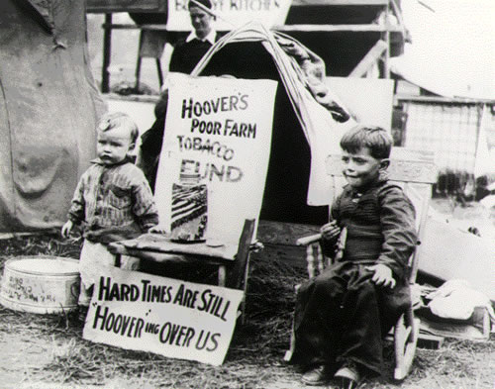
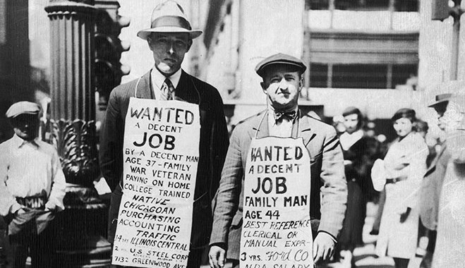
THE GREAT DEPRESSION BEGINS
The stock market crash marked the start of a 12-year economic and social disaster known as the Great Depression.
Tough times just continued to get tougher.

Slide 10
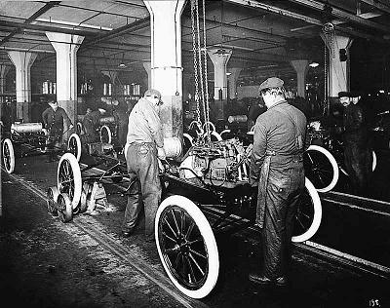
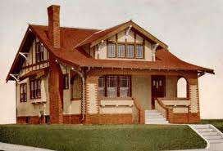
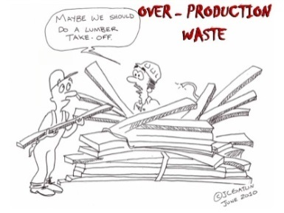
TROUBLED INDUSTRIES
One major cause of the Great Depression was overproduction.
Overproduction is a situation in which the supply of manufactures goods exceeds the demand.
Factories were producing more than people could afford to buy
With prices rising faster than salaries, many Americans cut back on their purchases.
Housing and automobile manufacture were in decline.

Slide 11
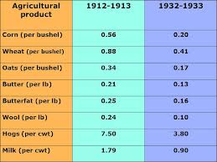
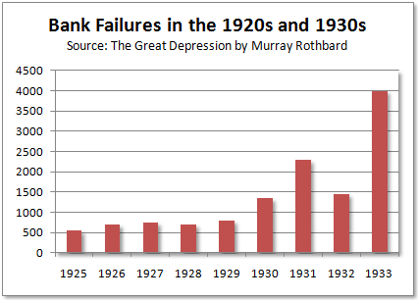
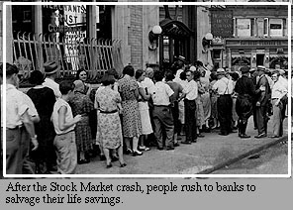
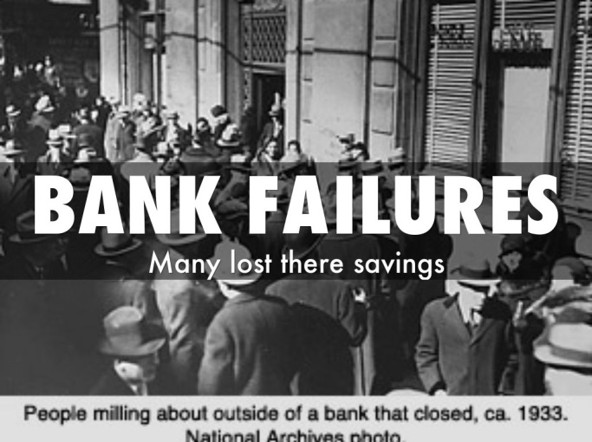
CRISIS IN BANKING
A nationwide banking crisis also contributed to the Depression.
In the countryside, struggling farmers were finding it impossible to repay their bank loans.
Some of the largest banks had invested in the stock market or loaned amounts to speculators.
After the crash, terrified depositors flocked into banks, demanding to withdraw their savings.
5,500 banks closed between 1930 and 1933.

Slide 12
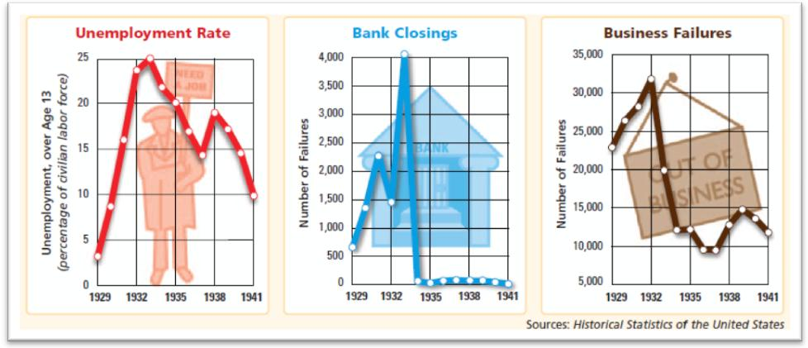

Slide 13
FARM
INDUSTRY

Slide 14
describe what the woman in this photograph is feeling?

Slide 15
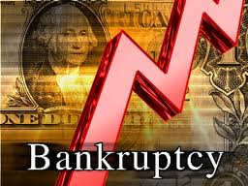
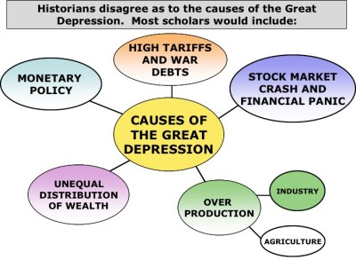
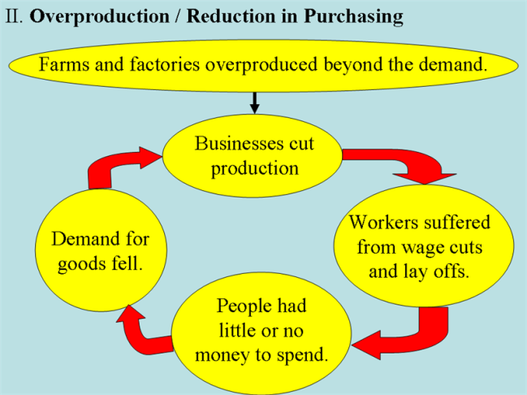
THE DOWNWARD SPIRAL
With people unable to buy what factories were producing, many workers lost their jobs.
In a vicious cycle, declining sales led to more factory closings and layoffs.
Many companies were forced into bankruptcy.
The Great Depression soon spread worldwide.
After World War I, many European nations owed America huge sums of money.
A slowdown in international trade, however, caused these countries to default.
What does it mean to default? -------------------→ To fail on repaying their loans

Slide 16
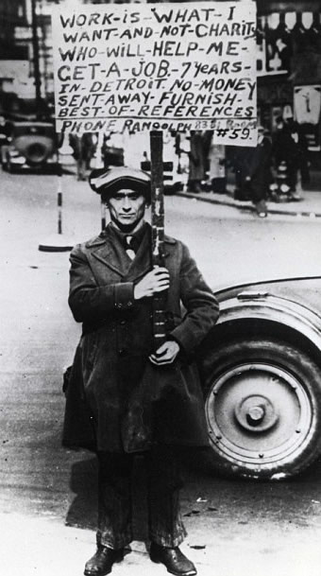
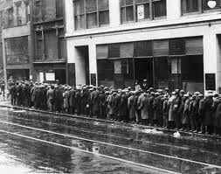
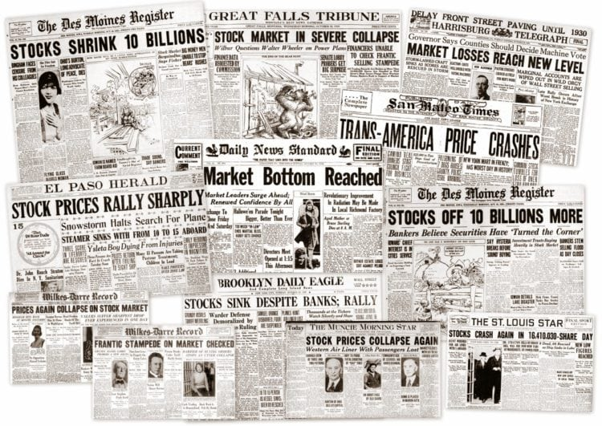
HUMAN COST
The Great Depression severely affected more people than any previous downturn.
During earlier depressions, most Americans still lived on farms.
They could feed their families in times of crisis.
By 1930, however, far more Americans lived in cities and worked in factories and offices.
When factories or businesses closed, the jobless had no money for food and no land on which to grow food.

Slide 17
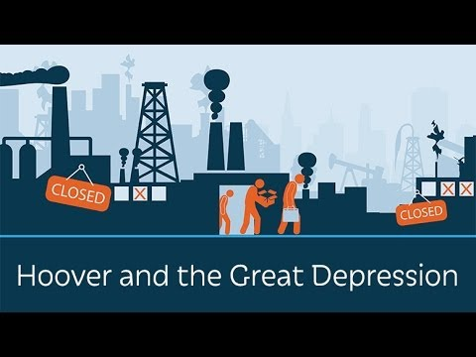
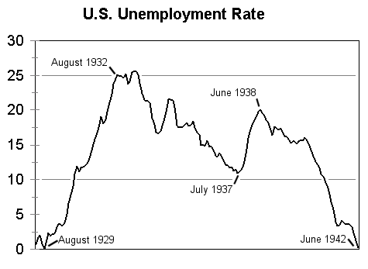
THE UNEMPLOYED
Between 1929 and 1933, the unemployment rate skyrocketed from 3 percent to 25 percent.
Nationwide, some 13 million people were unemployed.
People lucky enough to have jobs saw their hours cut back and their salaries slashed.

Slide 18
In what year does unemployment reach it’s highest percentage?

Slide 19
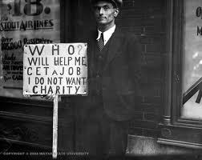
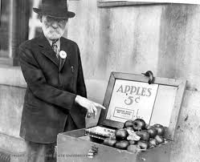
GROWING POVERTY
Jobless people lined up at soup kitchens, waiting for meals.
People tried to sell apples or pencils on the street or to pick up trash for food.
Survival instincts kick in.

Slide 20
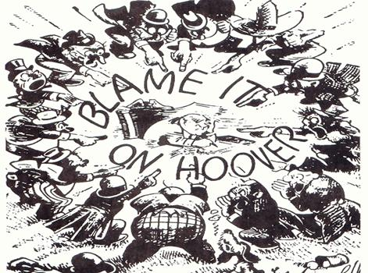

Slide 21
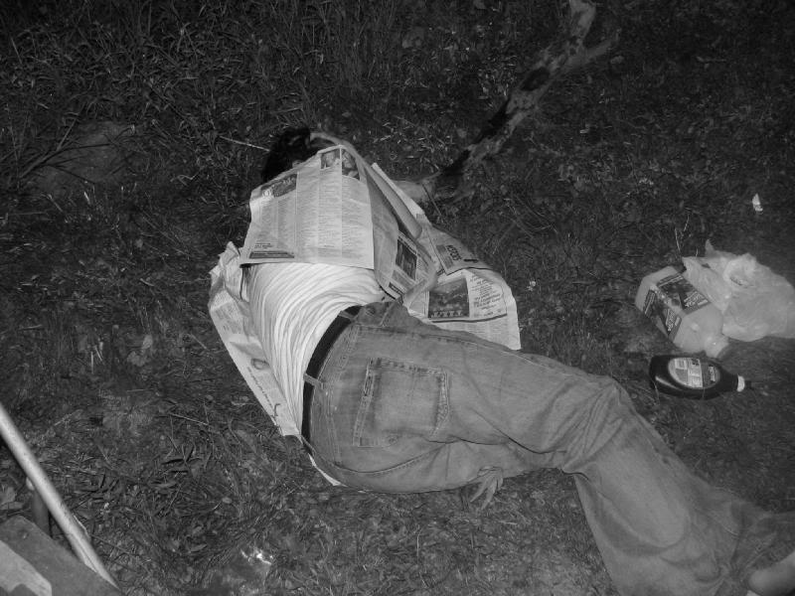
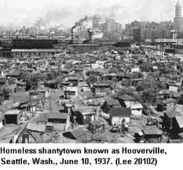
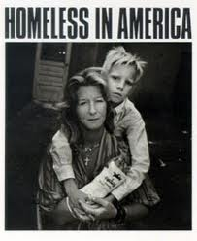
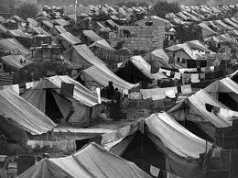
HOOVERVILLES
On the outskirts of big cities, homeless people built communities of rundown shacks.
They called these makeshift towns “Hoovervilles.”
They called them this because they blamed the President for failing to solve the crisis.
They slept under “Hoover blankets,” or newspapers.

Slide 22
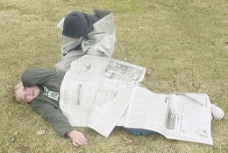
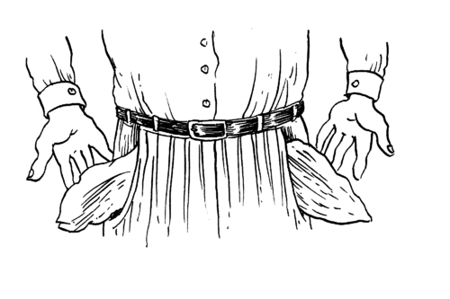
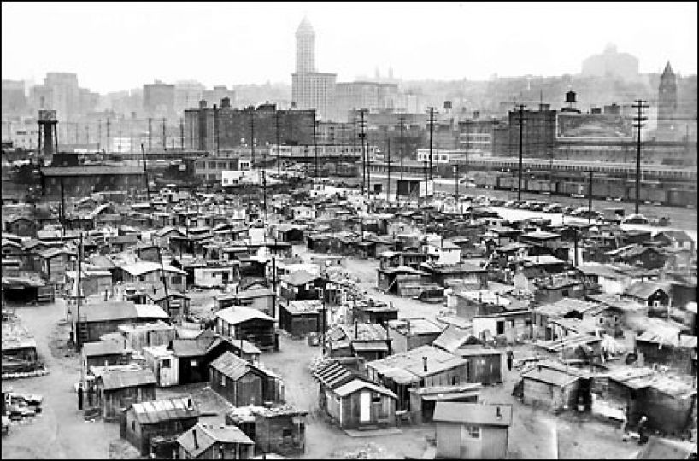
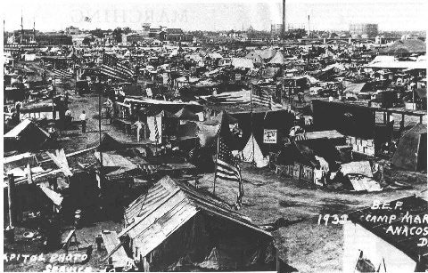

Slide 23
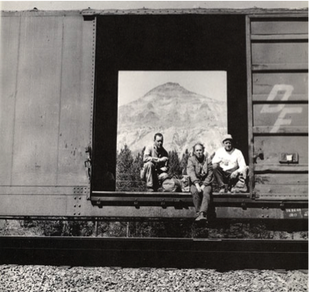
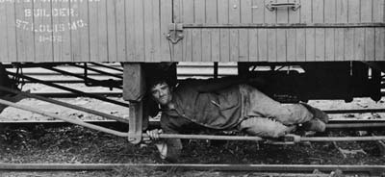
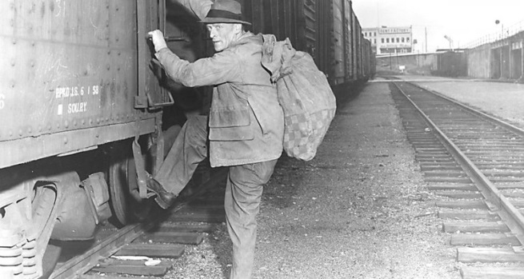
HOBO SIGNS

Slide 25
IMPACT ON FAMILIES
The Depression had a harsh effect on American families.
Many fathers left their homes in search of work.
Others, ashamed of being jobless, quit looking for work or deserted their families.
With their future uncertain, young people put off marriage plans
Couples that did marry had fewer children.
Why was this? The fear of not being able to provide
The Depression brought both hardship and a sense of uncertainty for the children of the Depression.
Many children suffered lifelong health problems from lack of food and dental care.

Slide 26
HOOVER RESPONDS
At first, Hoover’s advisors considered the Depression as a temporary setback.
They recommended doing nothing.
As the conditions worsened, and the finger of blame was placed solely on Hoover, steps were taken to assist the American people.

Slide 27
GOVERNMENT AID
Hoover believed that business leaders and local governments should take the lead, not the federal government in aiding the public.
Hoover encouraged city and state governments to create public works projects to employ jobless people.
He also urged private charities to set up soup kitchens.
In 1932, Hoover formed the Reconstruction Finance Corporation (RFC) to fund critical businesses, such as banks, insurance companies, and railroads
Despite such measures, the economic situation continued to worsen.

Slide 30
PRIMING THE PUMP
What does it mean to
“prime?”

Slide 31
THE BONUS ARMY
In June 1932, a protest began that would seal the President’s fate.
Eight years earlier, Congress had approved a bonus, of $1,000 for every veteran of World War I.
This bonus was not to be paid until 1945.

Slide 32
THE GREAT WAR VETERANS
World War I Veterans who demanded their bonus from Congress
Desperate by the Depression, some veterans demanded immediate payment.
When Hoover refused, an angry “Bonus Army” of at least 20,000 veterans marched to Washington D.C.
The Bonus Army refused to leave until they received their payment. The Veterans put pressure on Congress to grant them their bonus early.
Congress also rejected the plea.

Slide 33
Where do we go?
Most marchers left, but about 2,000 Veterans remained
With no money and no where to go this was their only hope.
Hoover did not like the negative attention the protest was causing.
He ordered the military to clear them out.
Tear gas, tanks, and machine guns were used to accomplish this task.
Many Americans were outraged by the image of government forces firing on unarmed veterans.

