Slide 1
Mr. Pitt and Mr. Reiter’s Remote – Hybrid Update
National Honor Society
Establishing a Virtual Community
Virtual Best-Practices

Slide 2
National Honor Society Anchors Chapter 2020 - 2021
Developed an electronic application process
Established an NHS Google Classroom for communication
Held first virtual meeting… with over 100 students
Working with D.O.T (Dutchess-Orange Tutoring), a not-for-profit, created and run by AHS alumni and current students
NHS officer elections are currently underway
NHS certificates have been signed and are ready for distribution
Our sincere appreciation and thanks to Patty Coppola for helping us in innumerable ways ☺

Slide 3
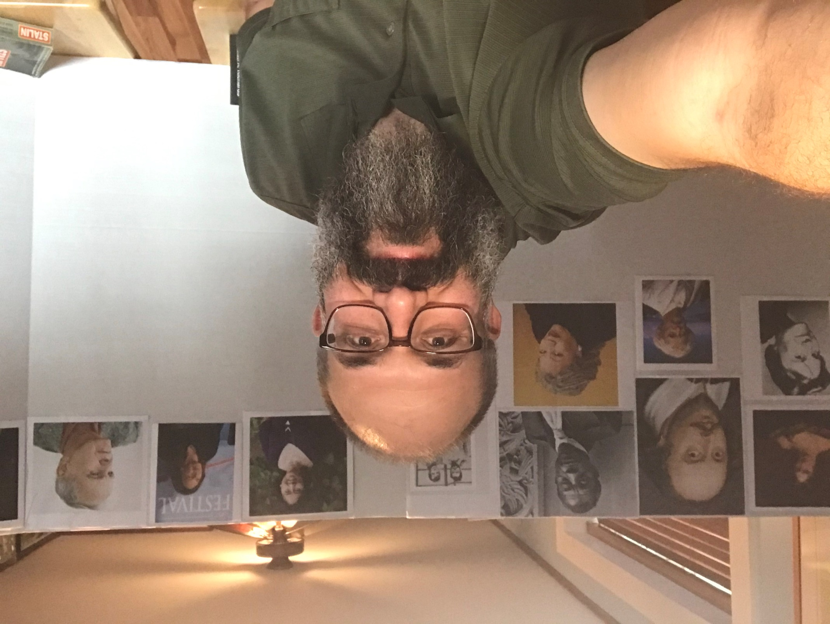
Mr. Pitt’s “Author Wall”
Every few days a new author is added
How many authors can you name?
(Answers on the next slide)

Slide 4
Mr. Pitt’s “Author Wall”
Top Row (left to right): Mary Shelley, William Shakespeare, James Baldwin, Allen Ginsberg, Jack Kerouac, Celeste Ng, Louise Erdrich, Cormac McCarthy
Bottom Row (left to right): Harper Lee, Mark Twain, Toni Morrison

Slide 5
Our cats have been eager to join our virtual classes. We have had several instances of them making surprise appearances during lessons. This has prompted our students to show their pets. Here is Mr. Reiter and Yeary.

Slide 6
Mr. Pitt and Cupcake

Slide 7
How well do you remember Shakespeare’s Macbeth? Play Macbeth Kahoot: Macbeth Kahoot

Slide 8
Mr. Reiter shares his artistic abilities with his Remote students.

Slide 9
Break-Out Rooms and Chat Functions
Small-group performances of plays
Small-group discussions
Individual contributions to questions, discussions, and activities.
Sharing links
Small-group projects

Slide 10
Mr. Pitt’s 10th graders recognized that their small groups did not have to be confined to their specific class. They decided to create groups with students in other periods, too.
The Misanthrope by Moliere
Curriculum Development Projects:
Sample Project

Slide 11
“The Arlington Central School District mission is to empower all students to be self-directed, lifelong learners, who willingly contribute to their community, and lead passionate, purposeful lives.”

