Slide 1
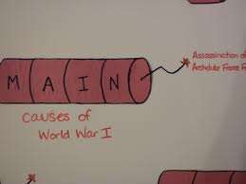
CHAPTER 21-1 THE ROAD TO WAR

Slide 3
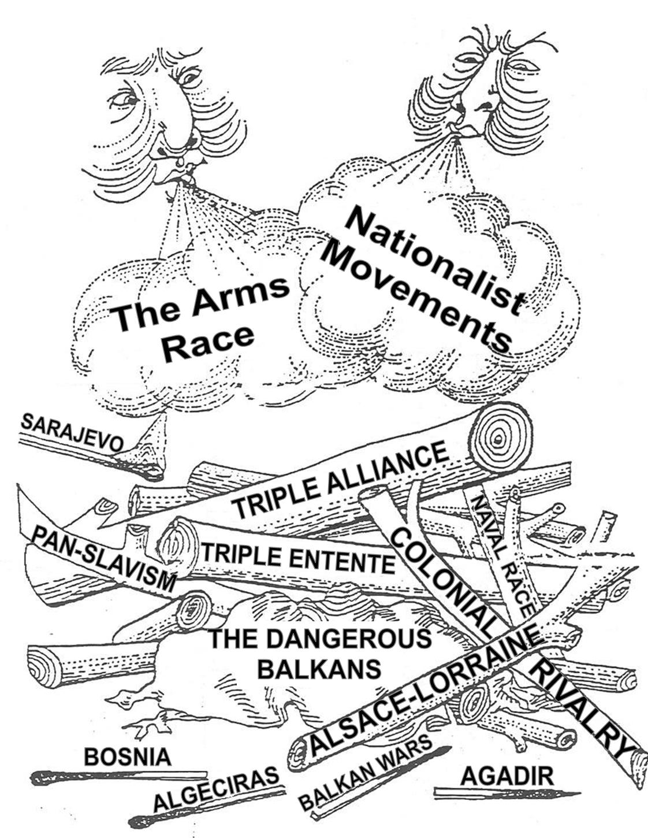
Origins of World War I
Militarism
Alliance System
Nationalism
Imperialism
Assassination

Slide 4
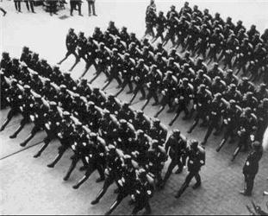
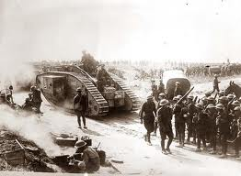
Militarism
military
What word do you see in militarism?
Militarism, or the glorification of the military
Militarism refers to the strengthening or build-up of a nations armed forces.
Nations build up their armed forces for self-protection and for national glory.

Slide 5
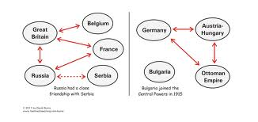
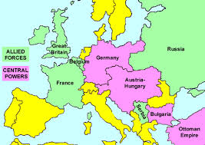
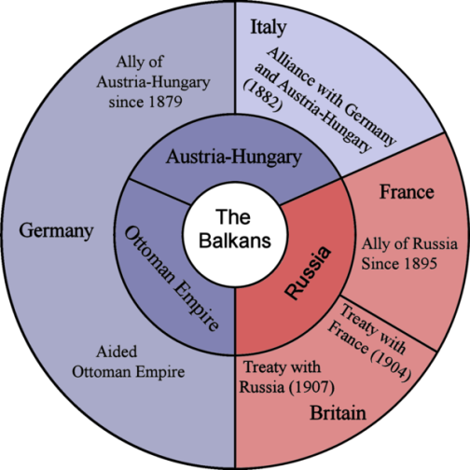
Alliance System
An alliance is an agreement between countries to aid and support one another.
As tensions mounted in Europe, alliance systems formed.
The alliance system meant that any conflict between two powers would quickly involve others.

Slide 6
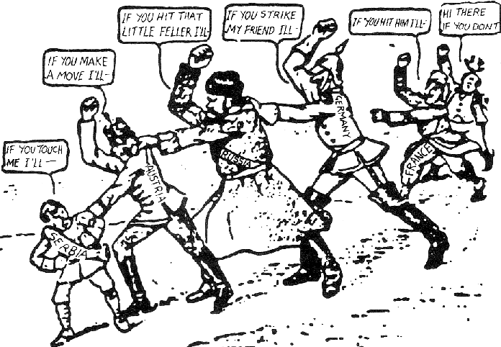
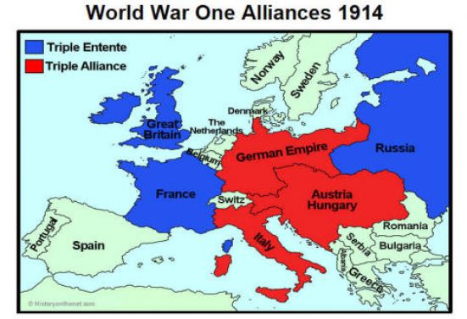
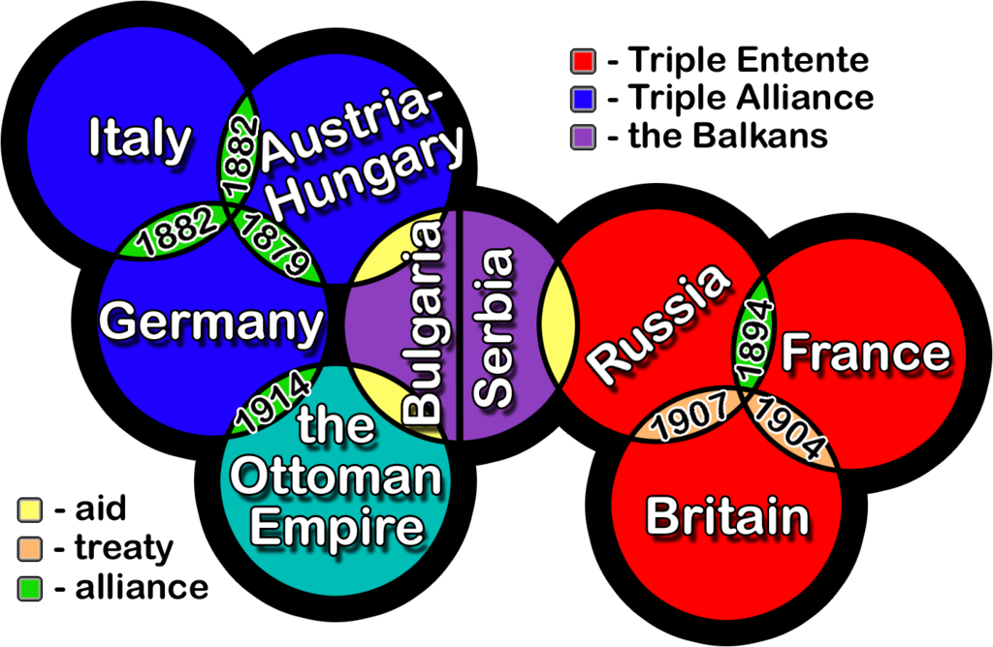
These were the two alliance systems put in place to keep balance in Europe prior to World War I
1. Triple Entente 1894
2. Triple Alliance 1879

Slide 7
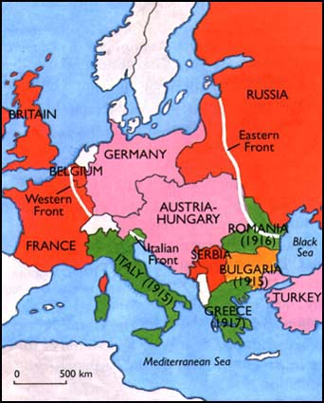
Central powers
Germany
Austria-Hungary
Ottoman Empire
AKA: Turkey
Bulgaria

Slide 8
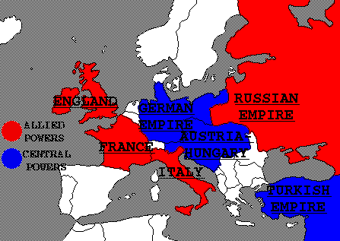
Allied powers
France
Great Britain (England)
Russian Empire
Italy
What country switched alliances?

Slide 9
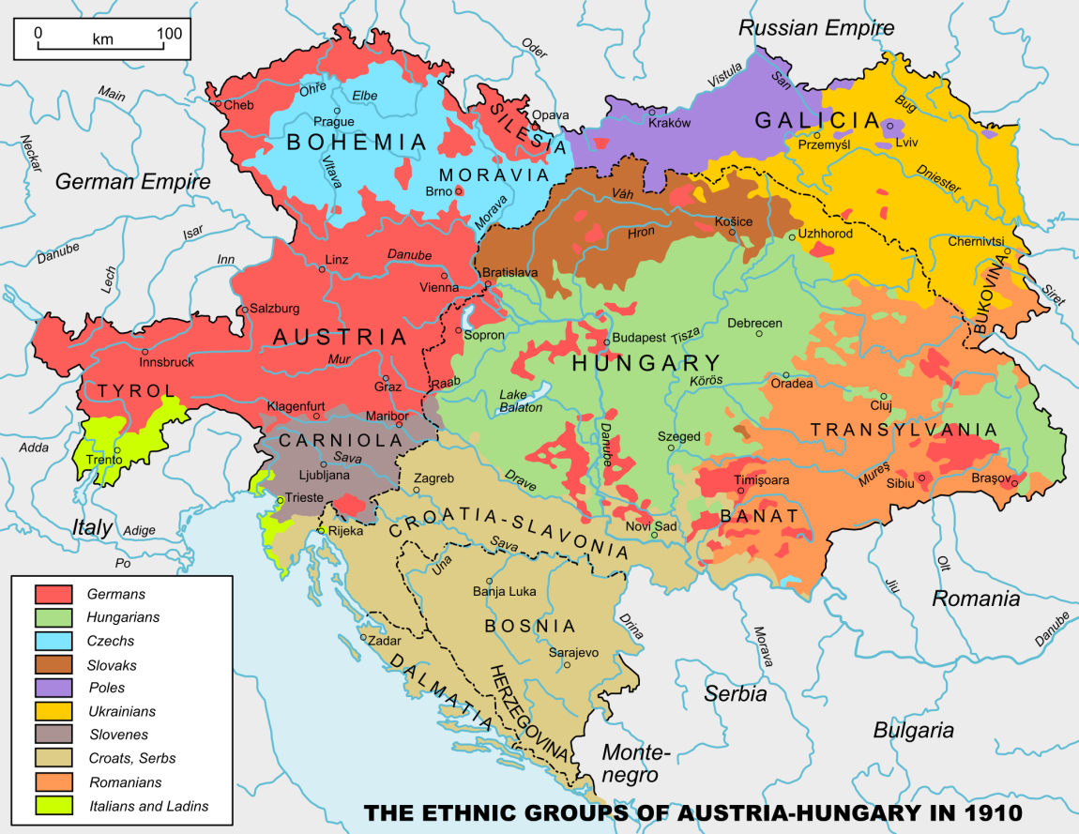
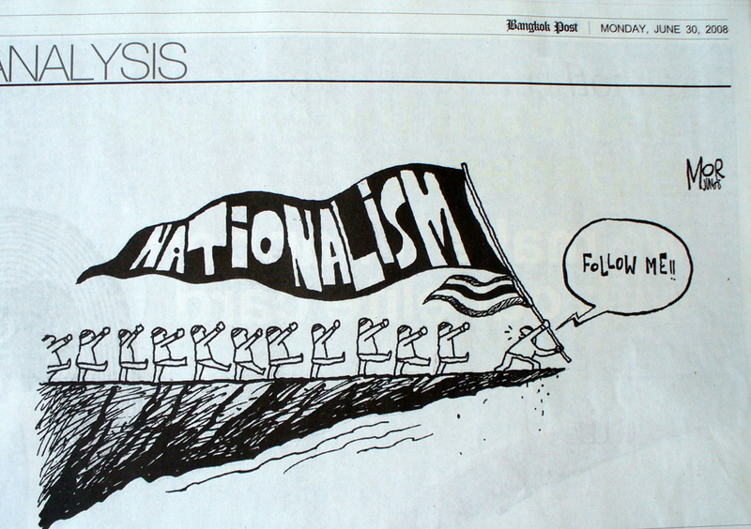
Nationalism
Nationalism is the pride in one’s nation or ethnic group.
What is an ethnic group?
Do you think nationalism is good for a country? Why or why not?
Look at how many different ethnic groups are living in Austria-Hungary in 1910.
Ethnic group - people of the same race or nationality who share a distinctive culture

Slide 10
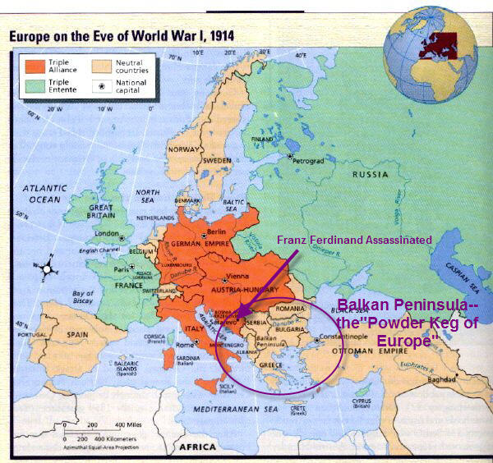
The Powder Keg
In the Balkan region of southeastern Europe, different national groups sought to break free from Austria-Hungary.
The Balkans are compared to a “powder keg”, or barrel of gunpowder.
Why?
This region of southern Europe was unstable.
Areas located in the southern part of the Austrian Hungarian Monarchy wanted to break free (become independent nations) and violence was imminent.

Slide 11
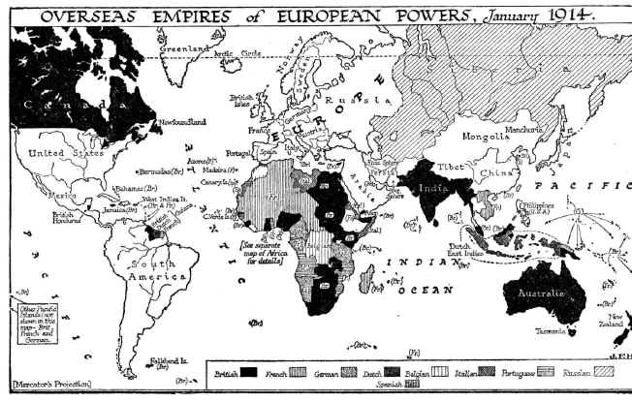
Imperialism
Imperialism is the building of an empire by imposing outside rule on peoples around the world.
P.E.R.M.S
European nations competed for trade and territory in Africa, Asia, and the Pacific.
Why did imperialism fuel the rise in militarism?

Slide 13
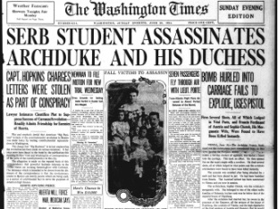
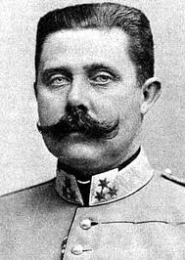
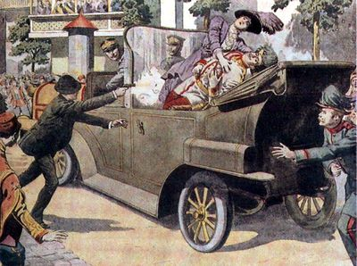
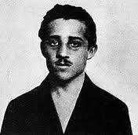
The Archduke is assassinated
The spark that set off the war came on June 28, 1914, in the Bosnian city of Sarajevo.
A Serbian nationalist, Gavrilo Princip, assassinated Archduke Franz Ferdinand.
He was the next in line to rule Austria-Hungary
Austria-Hungary accused the government of Serbia of supporting terrorism.
On July 29, Austria-Hungary declared war on Serbia
Gavrilo Princip
aka the assassin

Slide 14
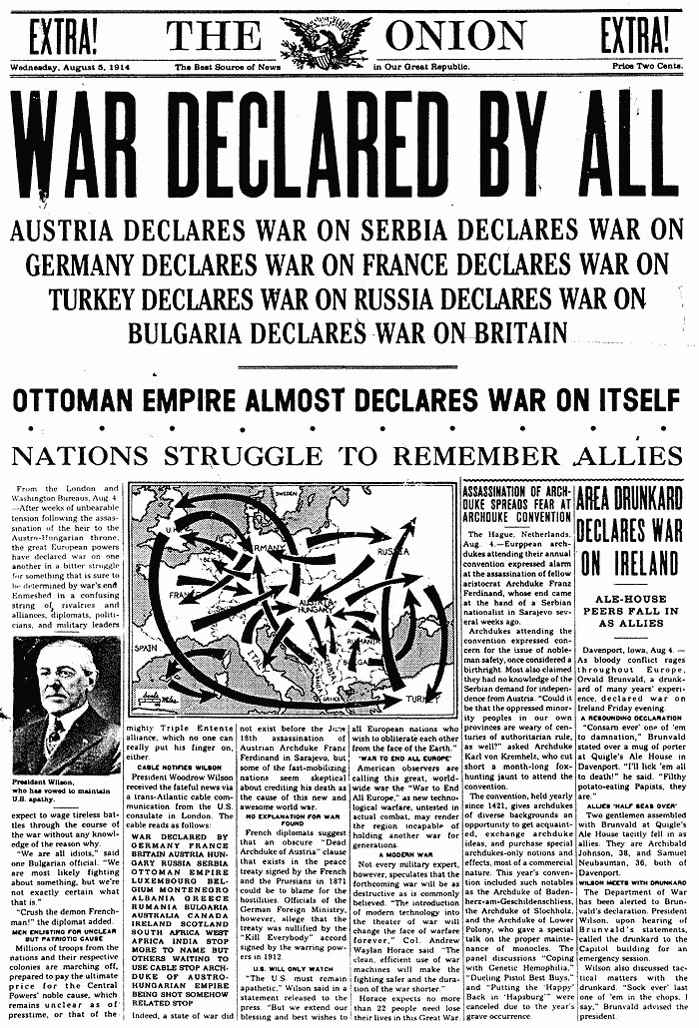
NATIONS BEGIN TO MOBILIZE
Austria-Hungary declares war on Serbia
Russia declares war on Austria-Hungary
Germany declares war on Russia
France declares war on Germany
CONTINUED!!!!!!!!!!!!

Slide 15
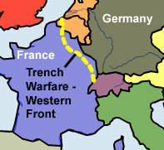
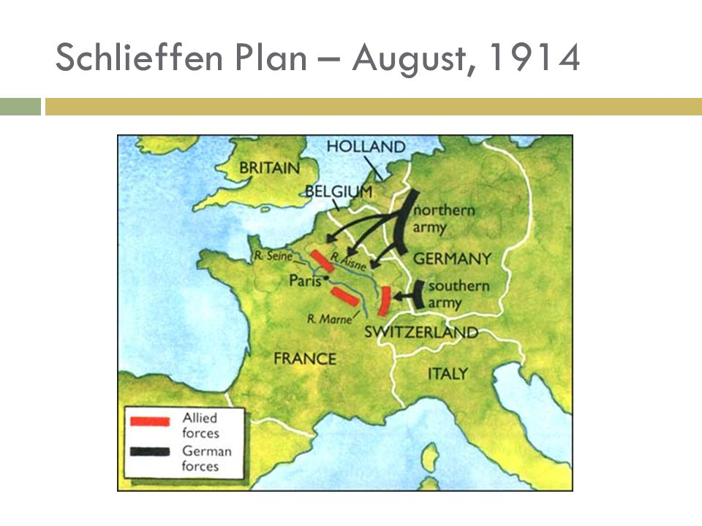
The Deadliest War
This is the reason why Great Britain joins the war.
German forces attack France through Belgium.
The German advance was halted 30 miles from Paris
The Western Front
Where fighting took place between France and Germany.
Fighting quickly settled into a long stalemate.
What is a stalemate?

Slide 16
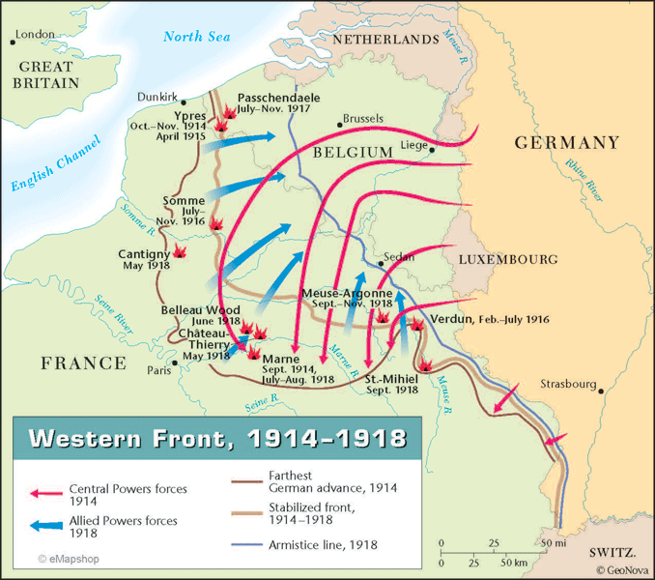
WESTERN FRONT
FIGHTING THAT OCCURRED BETWEEN GERMANY AND FRANCE

Slide 17
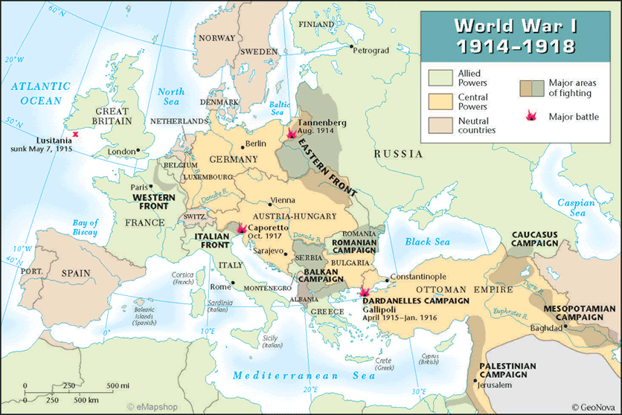
Western Front: Fighting between Germany and France
Eastern Front: Fighting between Germany and Russia

Slide 18
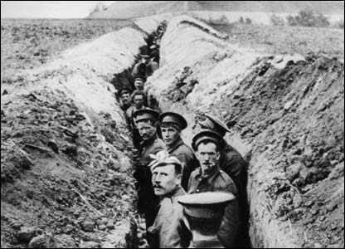
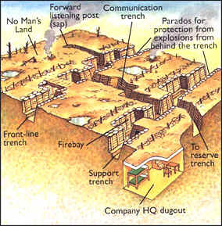
Trench Warfare
Along the Western Front, trench warfare fed the stalemate.
Why are trenches dug during war?
Positional warfare, neither side wanted to lose ground.
Protection from enemy fire.
The land between the lines (trenches) was an unoccupied territory known as “no man’s land.”

Slide 19
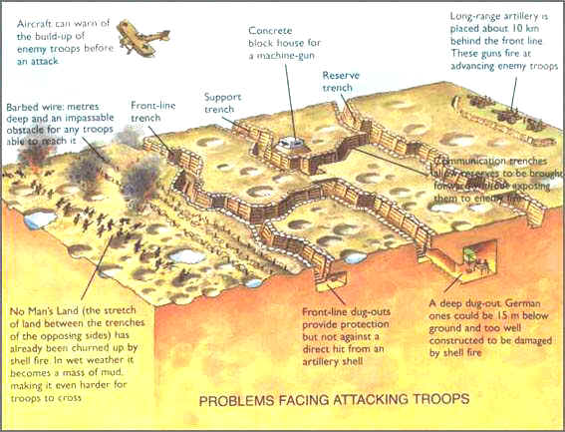

Slide 20
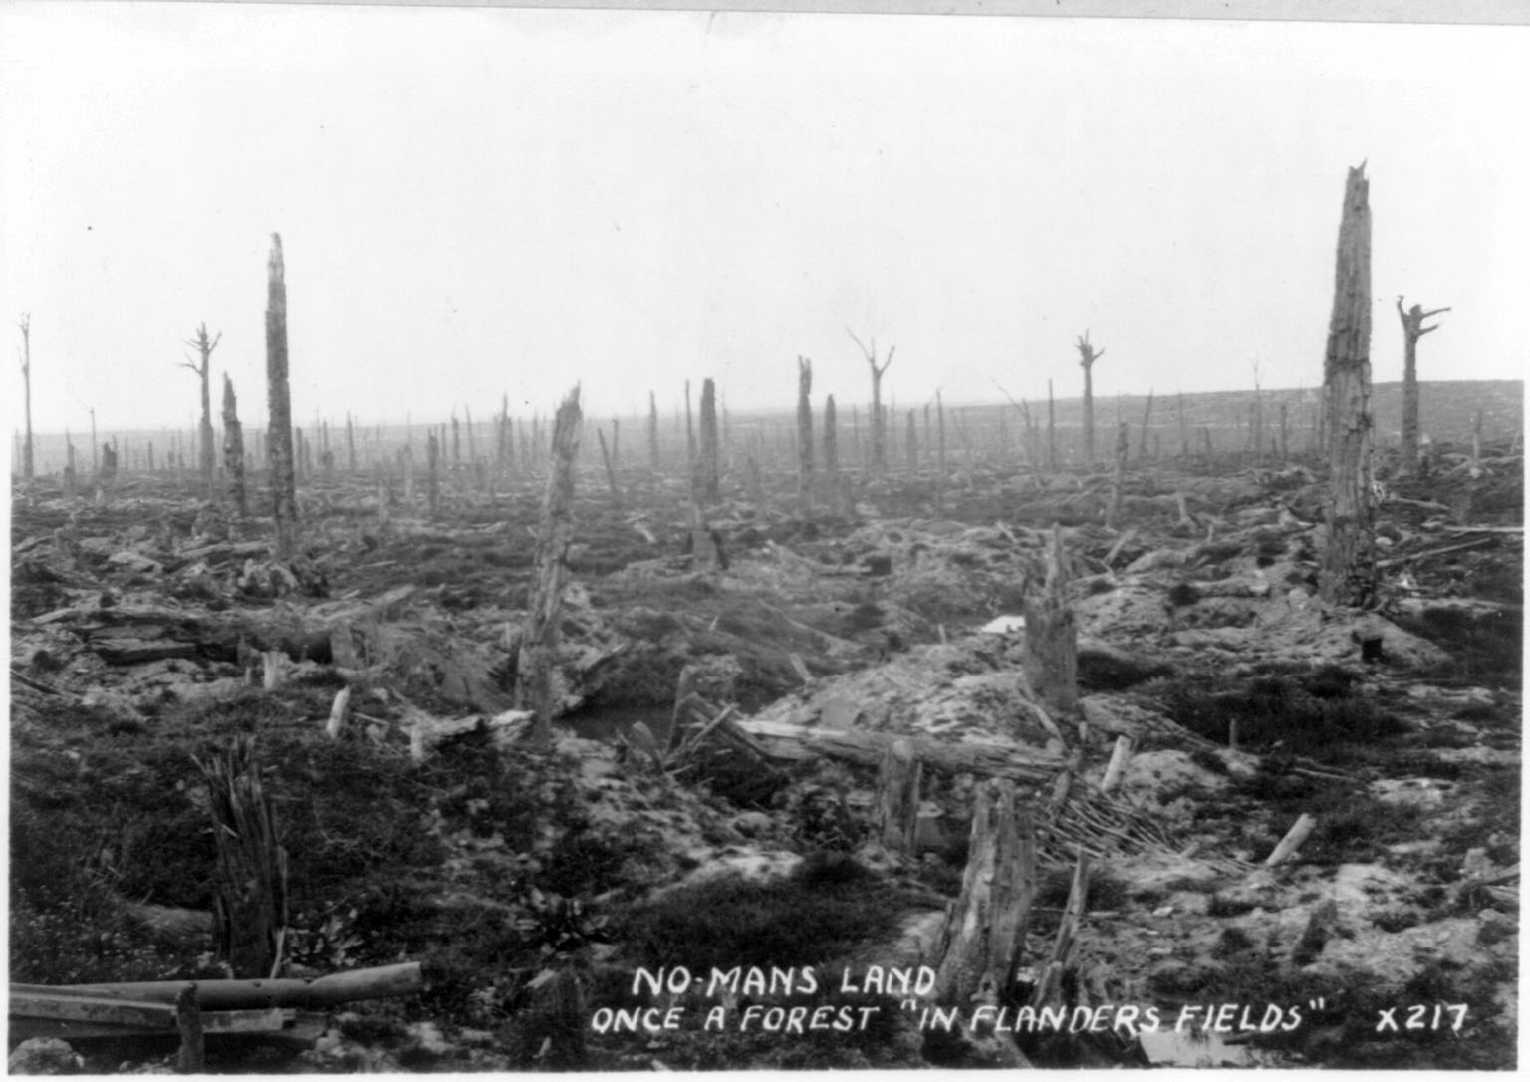
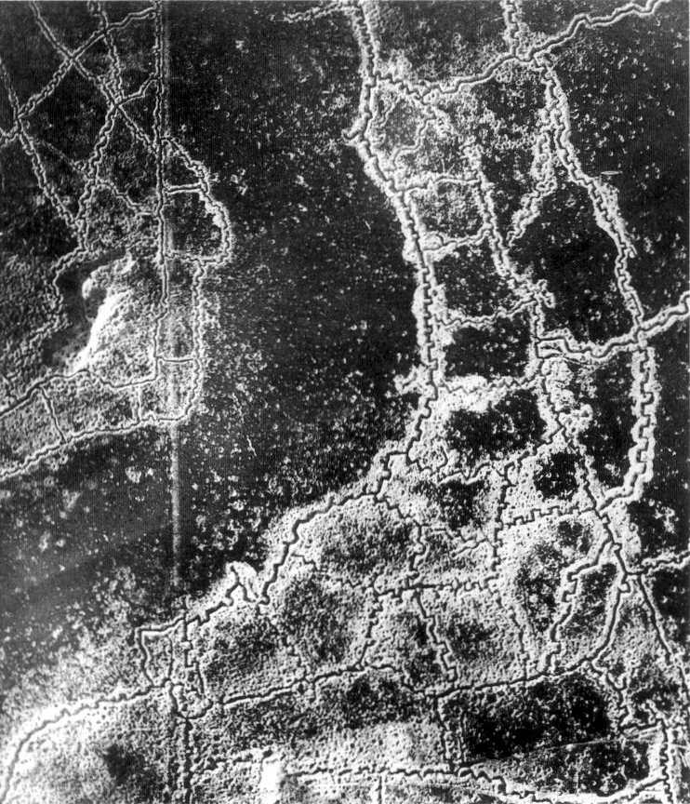
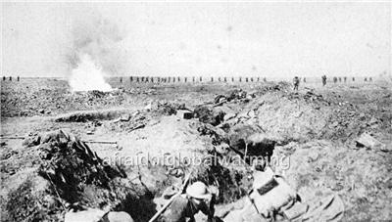

Slide 21
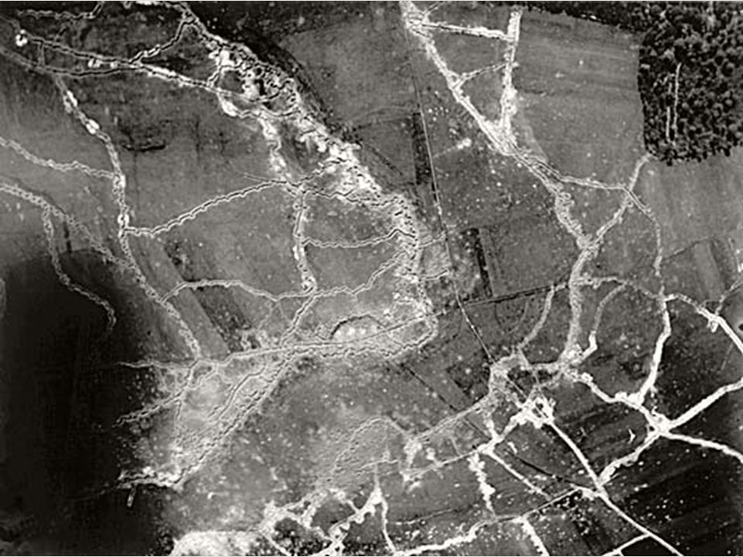

Slide 22
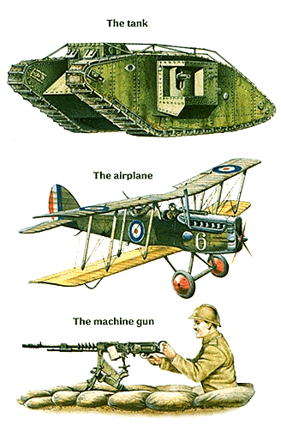
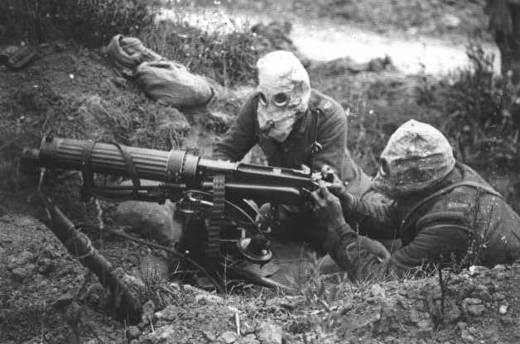
Technological advances
Advances in technology made the war more lethal.
Airplanes
used for scouting and support for ground troops.
Armored tanks
Rapid-fire machine guns
Heavy artillery
Poison gas
Various gases caused choking, blinding, or severe skin blisters

Slide 23
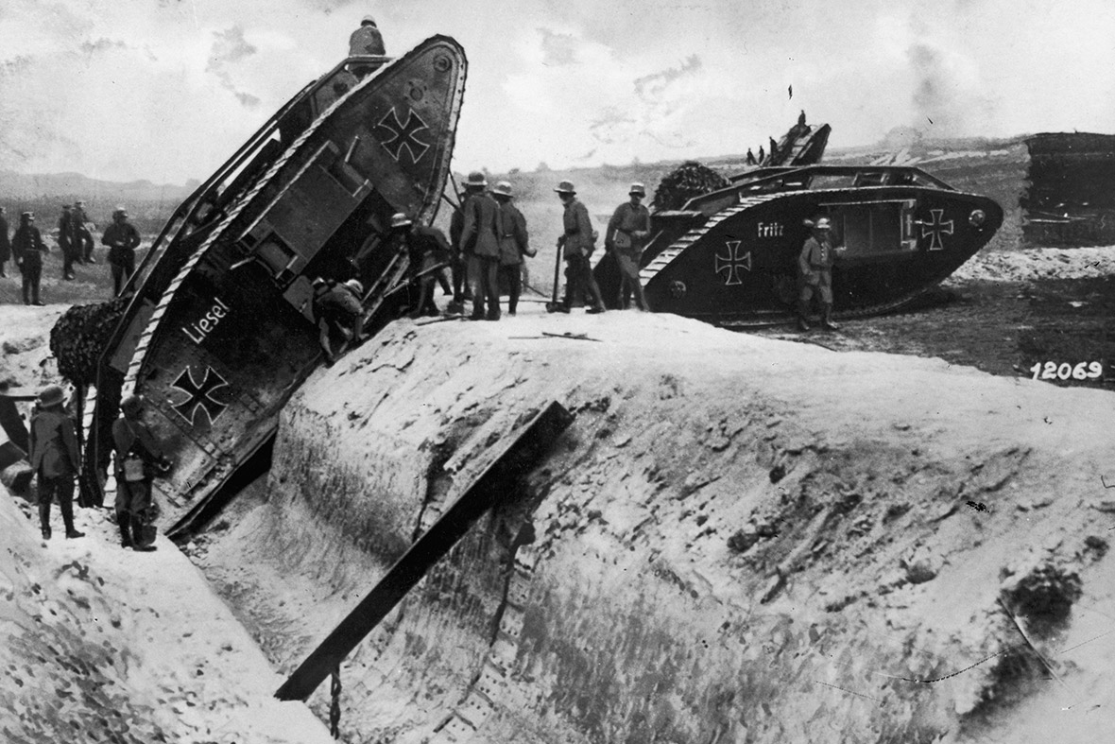

Slide 24
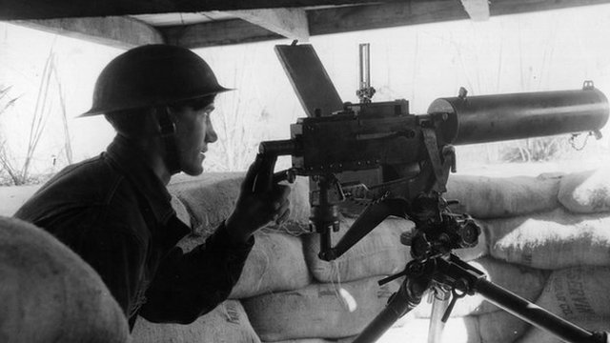
I dare you… make my day!
What new advancement in technology are we looking at?
Explain why a machine gun, in comparison to a pistol, is extremely lethal in combat.

Slide 25
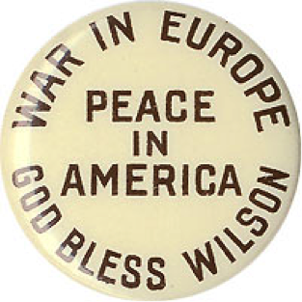
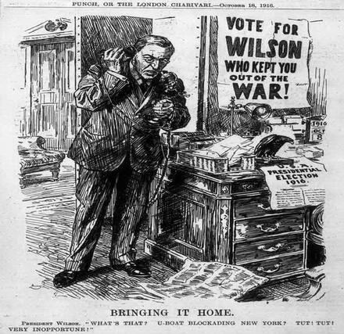
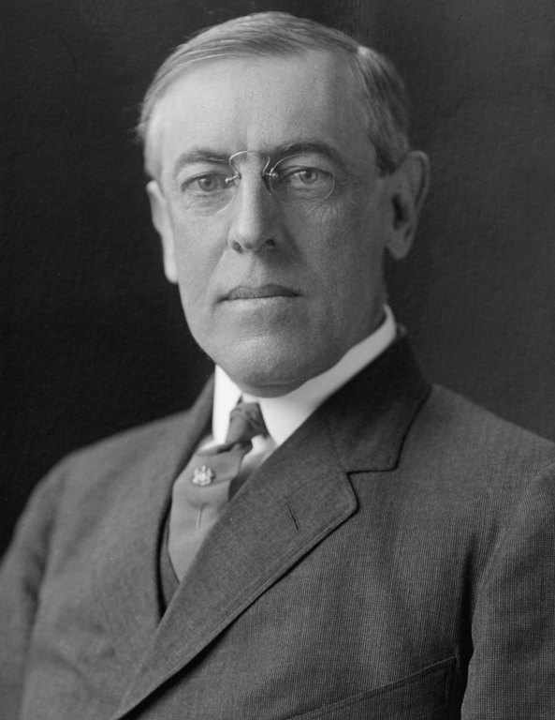
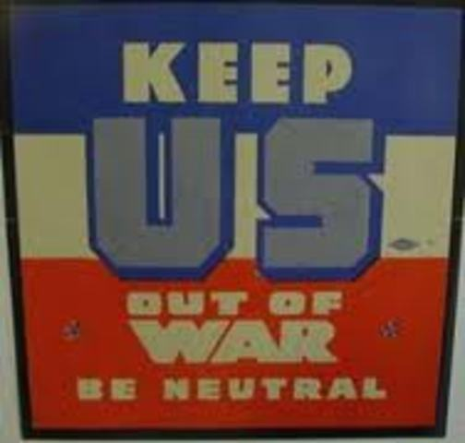
American Neutrality
When war broke out in Europe, the U.S. stayed out!!
What does it mean to be neutral?
President Wilson was horrified by the bloodshed in Europe and sought to keep the United States out of the war.

Slide 26
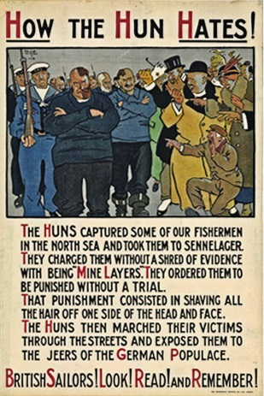
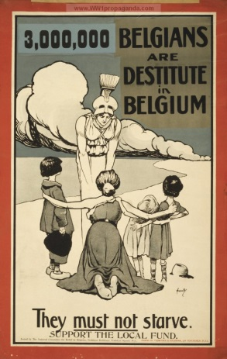
Ethnic Loyalties
Americans were divided on which side to support.
German-Americans generally supported the Central powers.
Most Americans favored the Allies (Britain) because of the shared language and history.
Britain used propaganda to win American support.
British propaganda often focused on Germany’s brutal treatment of the Belgians at the start of the war.
Many of the most horrifying tales were exaggerated.

Slide 28
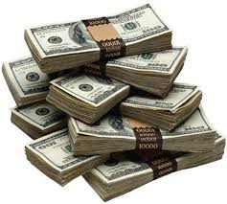
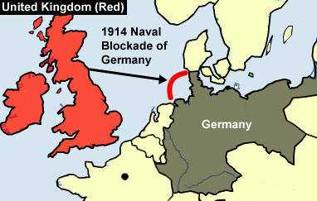
Supplying the Allies
The U.S. economy benefitted during the war since they produced and sold supplies to both sides.
American firms were free to sell to both sides, but most American trade was with the Allies.
The same could be said about bank loans. Larger loans were handed out to the Allied nations.
Was the U.S. truly neutral?
NO!! They favored the Allies. The U.S. provided the Allies with more money and weapons then the Central Powers.
What is a blockade?
No one passes
What is a U-boat?
Submarines

Slide 29
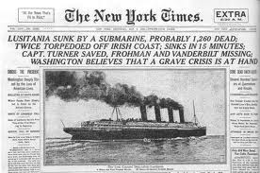
The Lusitania
On May 7, 1915, a U-boat sank a British passenger liner, the Lusitania, off the coast of Ireland.
Nearly 1,200 people died, 128 of them were Americans.
Why did a German submarine fire a torpedo at the passenger ship?
Wilson made angry protests to Germany.
Germany responded by halting U-boat attacks on passenger liners and neutral merchant ships .
Why do you think Germany stopped such attacks?
The Germans unrestricted submarine warfare upset the U.S.

Slide 30
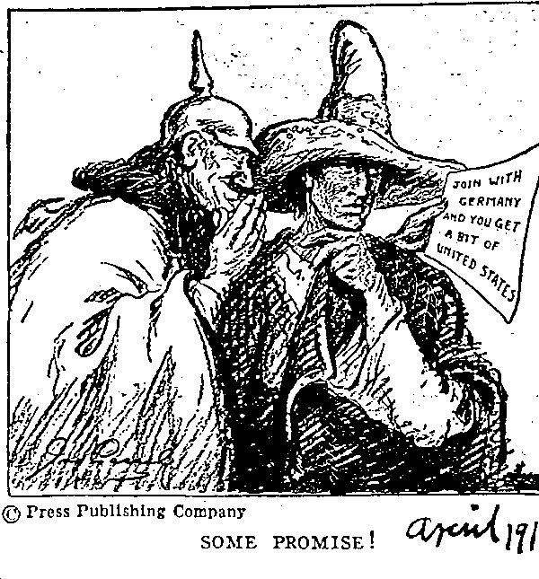
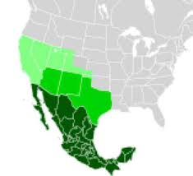
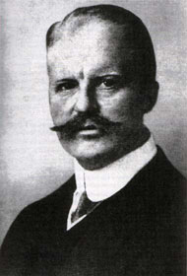
Zimmermann Telegram
On February 24, Wilson was shown a telegram that the British had intercepted.
Germany’s foreign minister, Arthur Zimmermann proposed that Mexico join the war on Germany’s side.
The Zimmermann Telegram was released to the press on March 1.
How do you think Americans responded to the release of the telegram?

Slide 31
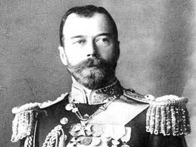
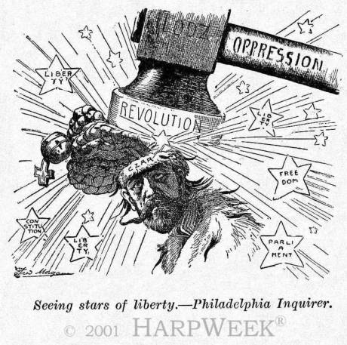
Russian Revolution
In March 1917, military defeats and food shortages led to an uprising.
The Tsar (emperor) Nicholas II was overthrown.
The fall of the tsar made it easier for the United States to enter the war. By joining with the Allied powers, the United States would not be siding with a tyrant.

Slide 32
Declaring War
On April 2, 1917, Wilson asked Congress to declare war against the Central powers.
His goal, he declared, was to fight to make the world “safe for democracy.”
Congress overwhelmingly gave its approval

