Slide 1
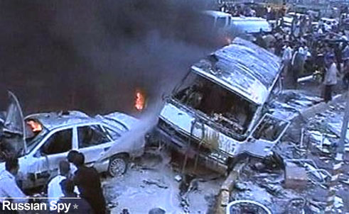
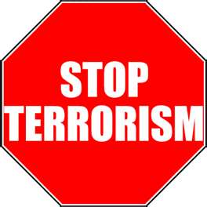
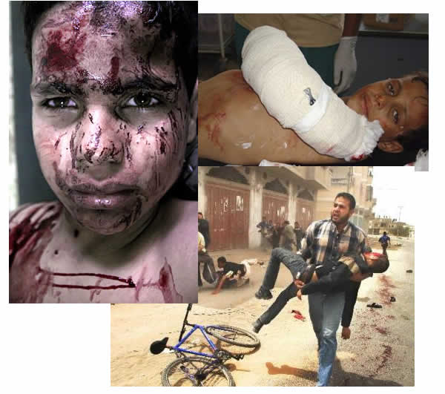
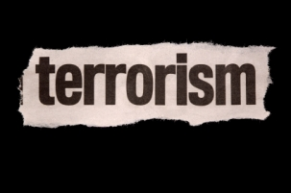
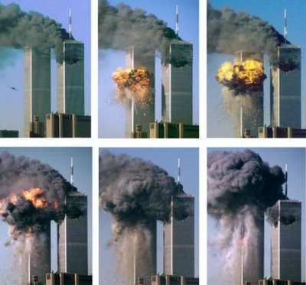
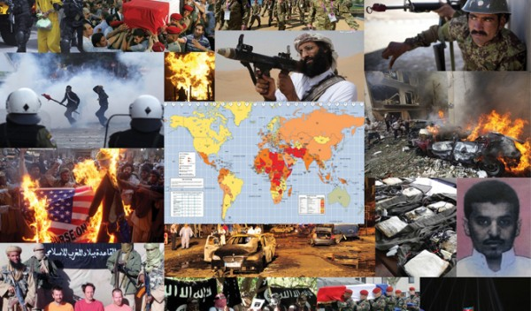
The Threat of Terrorism
September 11, 2001

Slide 2
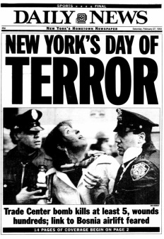
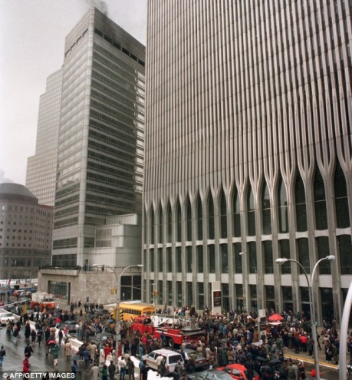
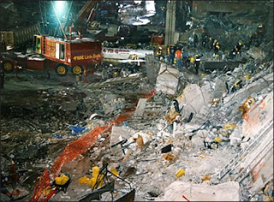
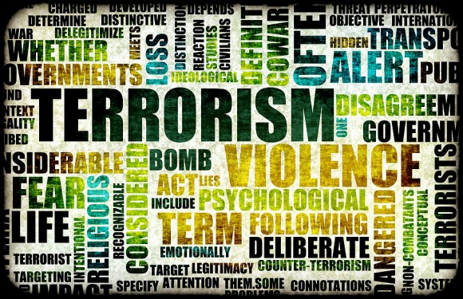
Terrorism
Terrorism: the use of violence, often against civilians, to force political or social change.
Middle Eastern extremists use terrorism to reduce Western influence.
The first terrorist attacks against Americans occurred abroad.
The first terrorist attack on American soil occurred in 1993.
A truck bomb exploded under the World Trade Center in New York City
Six people were killed

Slide 3
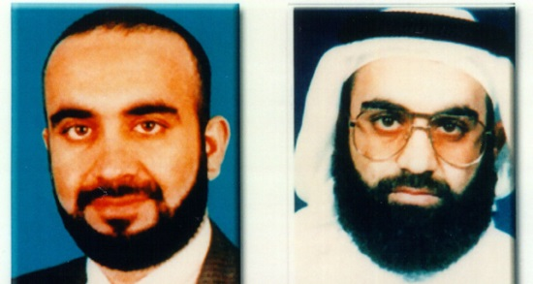
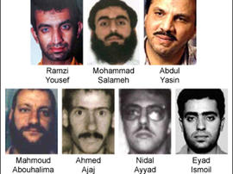
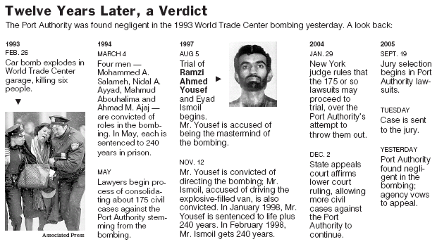
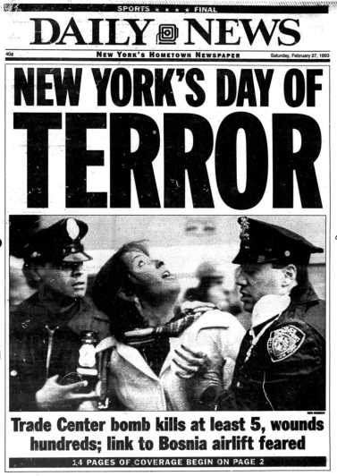
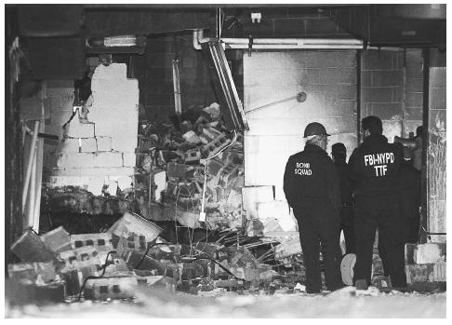
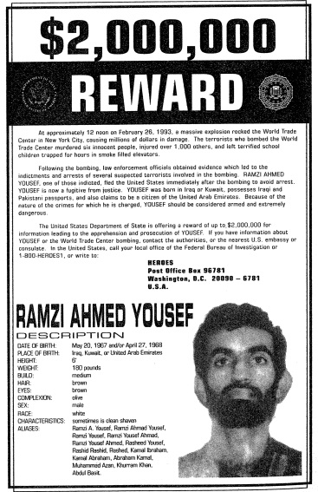
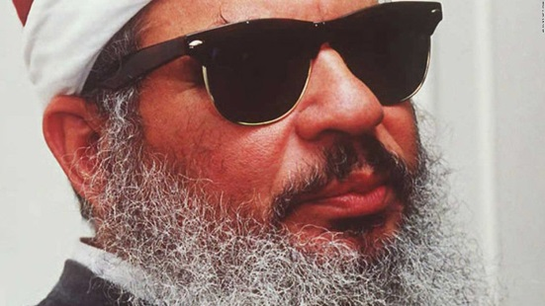
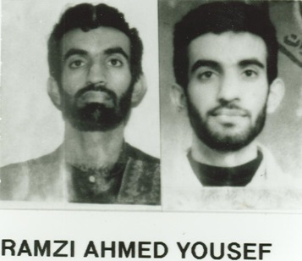
Omar Abdel-Rahman

Slide 4
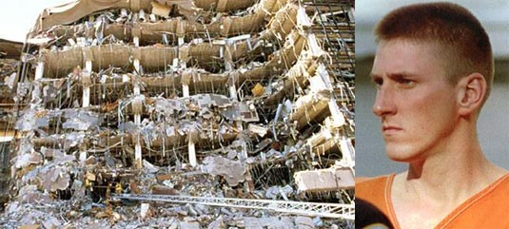
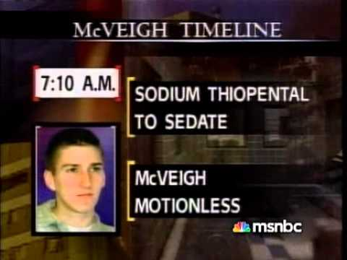
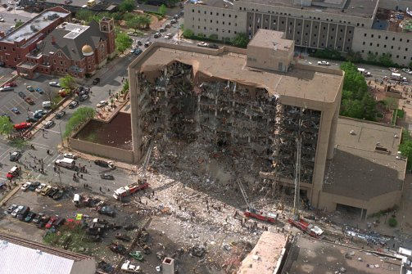
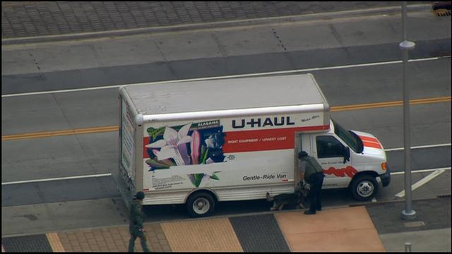
Terror at HOME
In 1995, a truck bomb exploded near a federal office building in Oklahoma City
168 people were killed
The terrorists in this attack were two young American men who resented the federal government.

Slide 5
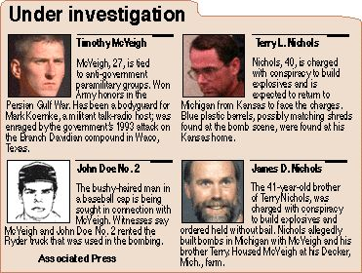
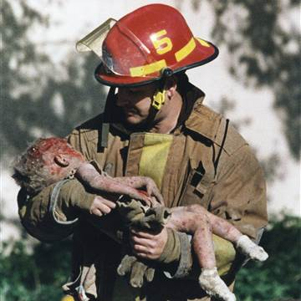
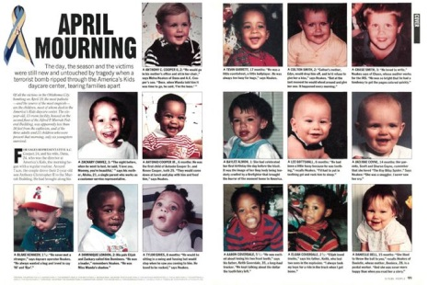
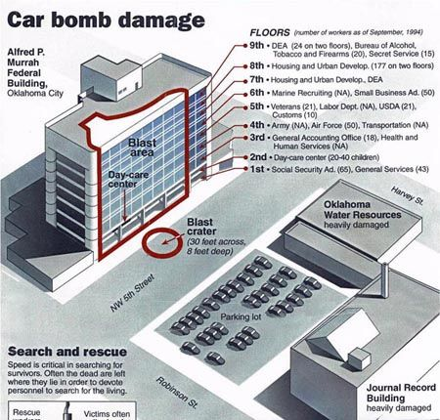
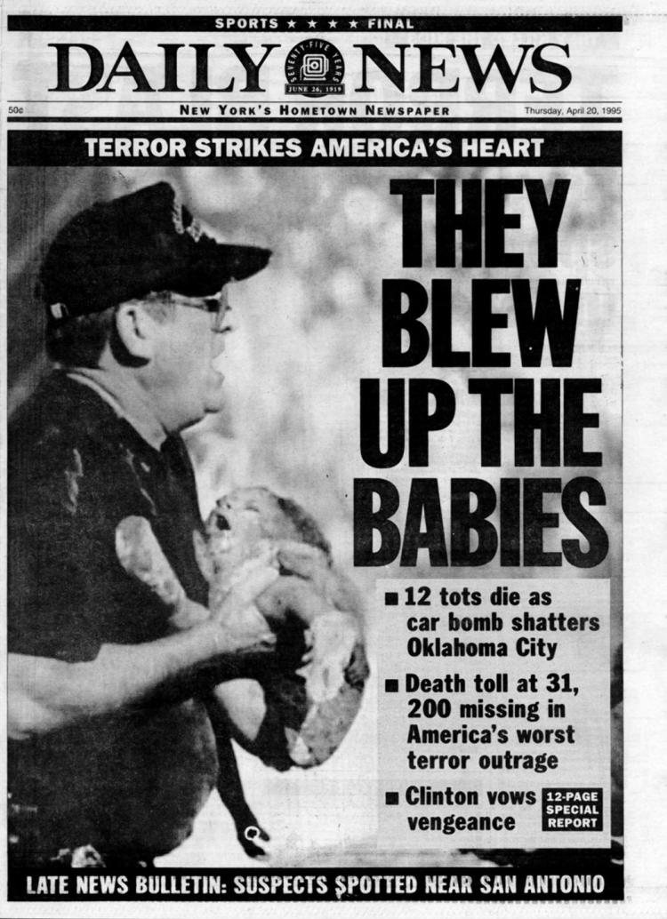

Slide 6
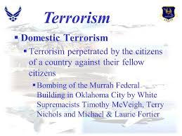
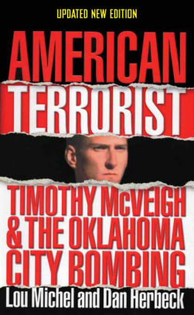
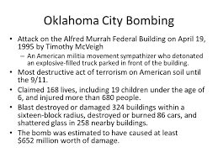

Slide 7
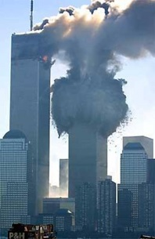
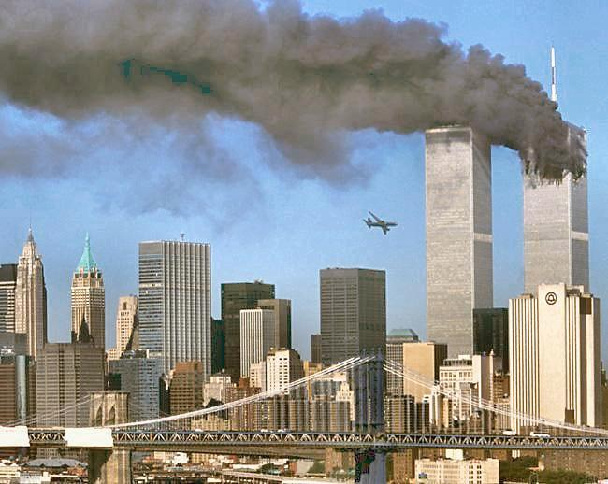
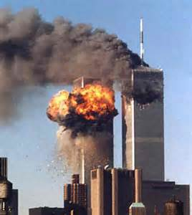
9/11/2001
On September 11, 2001, Arab terrorists hijacked four passenger jets.
The terrorists crashed two of the planes into the World Trade Center in New York City.
Both towers of the WTC collapsed.
They crashed a third plane into the Pentagon in Washington, D.C.
The fourth jet crashed into a field in Pennsylvania.
Nearly 3,000 people were killed in New York, at the Pentagon, or on the airplanes.

Slide 8
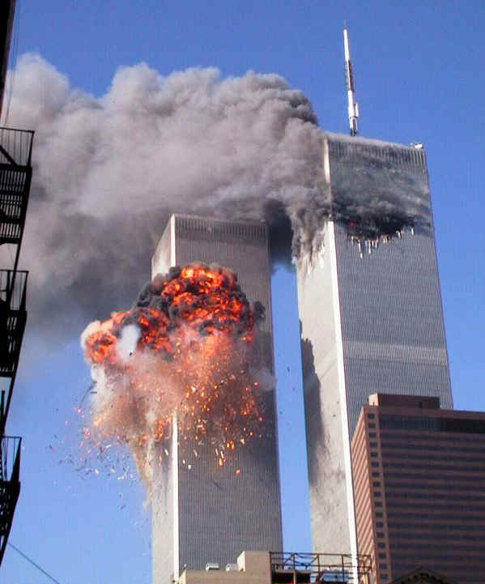
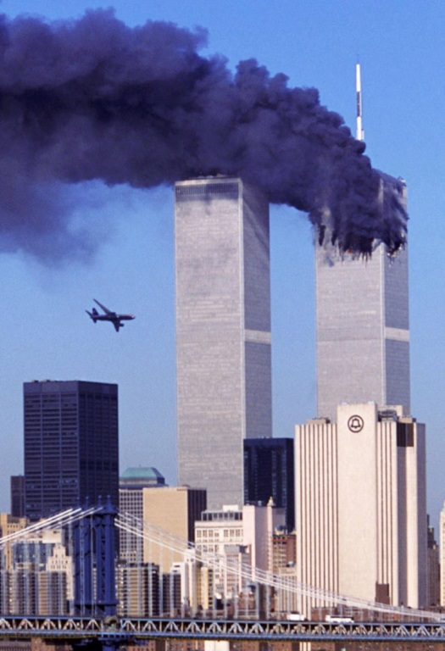
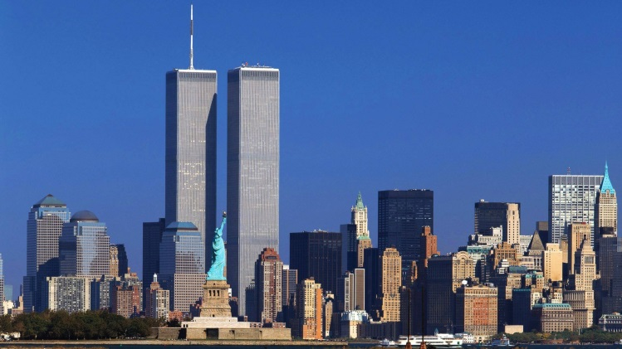
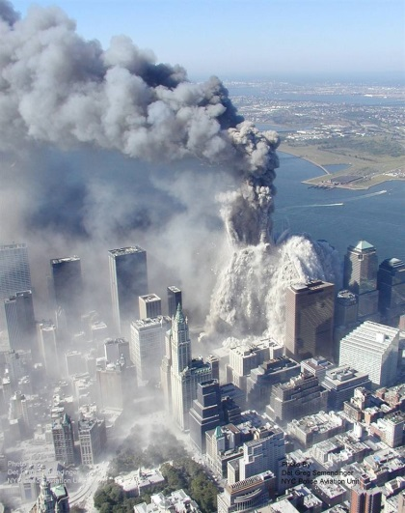
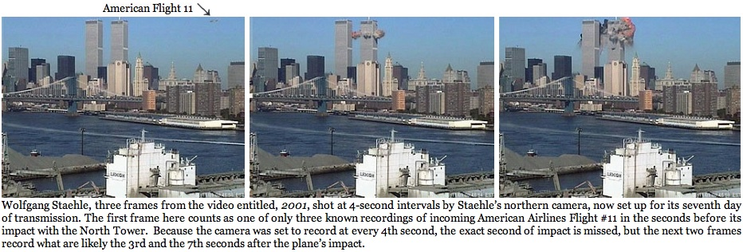
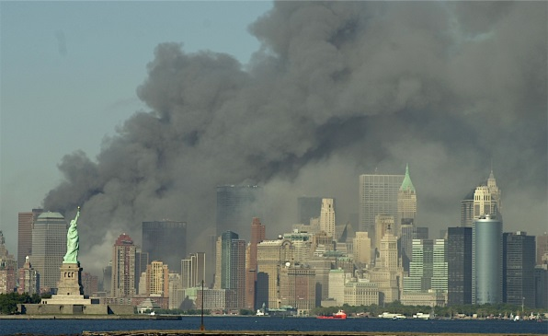
9/11/2001

Slide 9
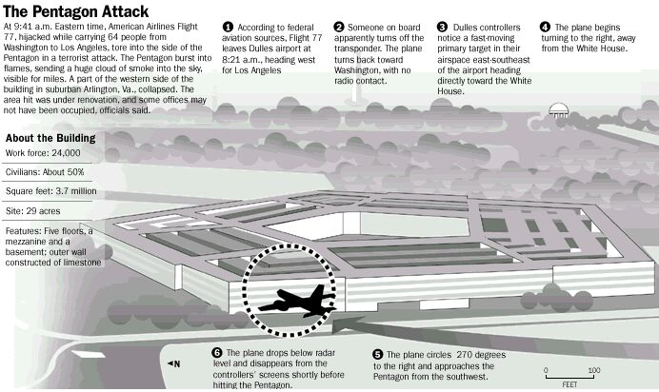

Slide 10
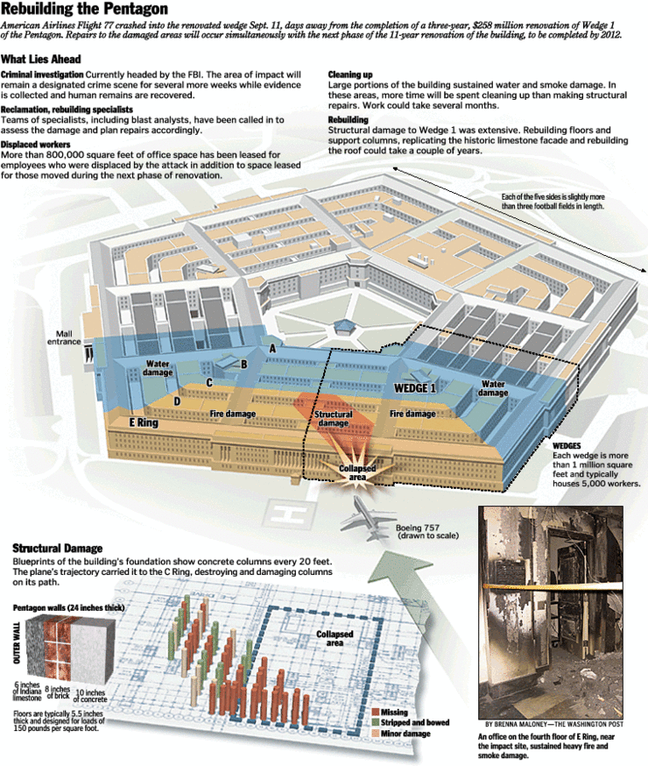

Slide 11
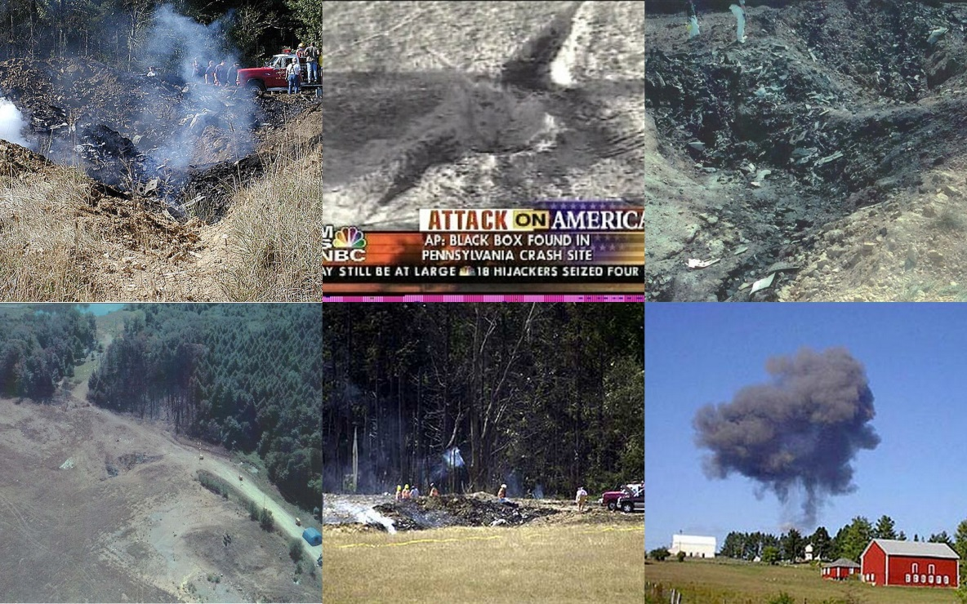
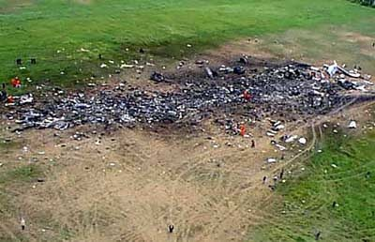
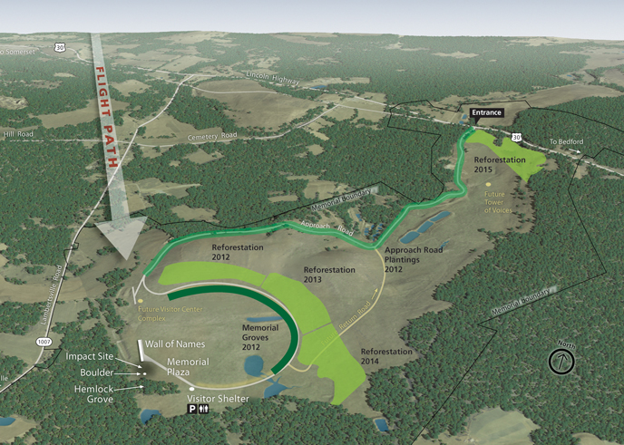
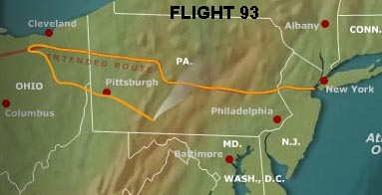
Shanksville, Pa.

Slide 12
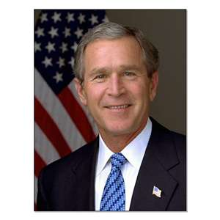
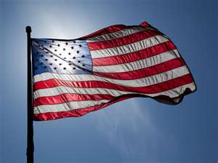
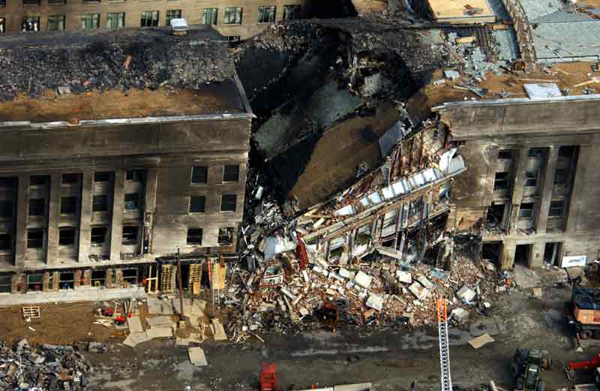
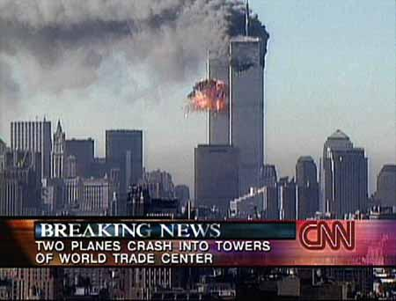
The Nation Reacts
The tragedy of September 11th left Americans shocked and angry.
Americans around the country flew flags and took part in candlelight vigils.
People around the world voiced their sympathy and support.
President George W. Bush expressed the nation’s outrage.
He vowed to “hunt down and punish those responsible.”

Slide 13
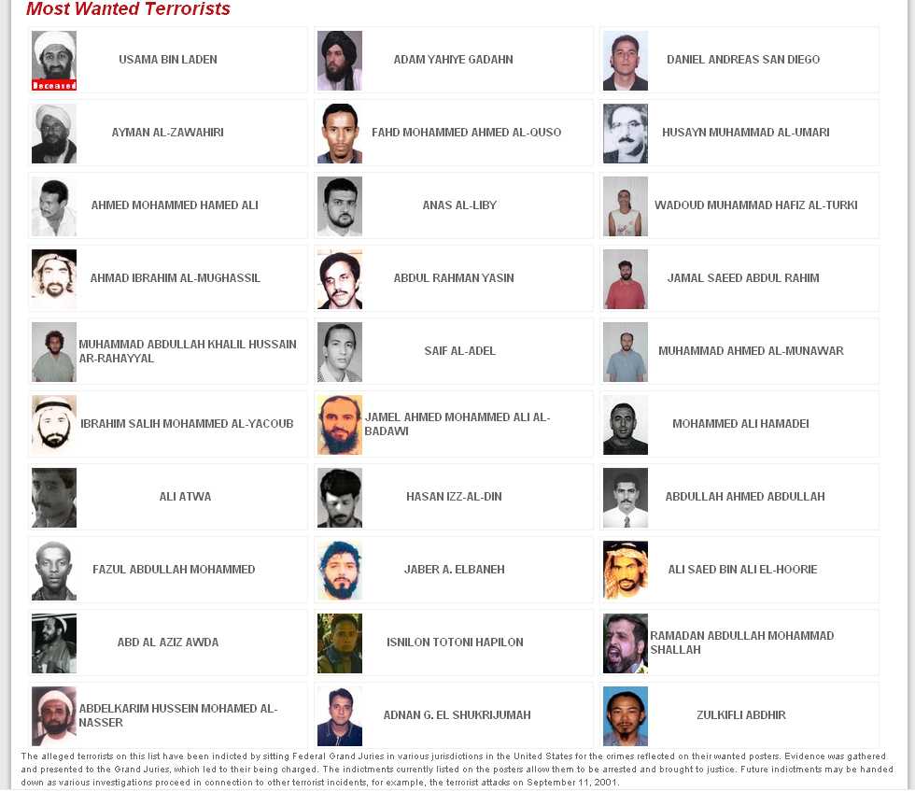
Most Wanted List- Post 9/11/01
Osama Bin Laden

Slide 14
Defending the Homeland
Bush took steps to protect the nation.
He created the Office of Homeland Security
This department coordinates the country’s counterterrorism efforts.
Counterterrorism- action taken against terrorism
Counterterrorist goals include identifying and locating terrorists and safeguarding vital transportation, communication, and energy systems.

Slide 16
PATRIOT ACT
In December 2001, Bush signed the Patriot Act.
This act granted authorities sweeping powers to investigate and jail people suspected of having terrorist ties.
The Patriot Act was controversial
WHY?
(+) Some people felt such strong measures were necessary for national security.
(-) Others believed the law was a threat to the liberties guaranteed in the Bill of Rights.

Slide 18
The War on Terror
A suspect in the September 11 attacks soon emerged.
Osama Bin Laden
He was a wealthy Saudi Arabian who ran a worldwide terrorist network called al Qaeda

Slide 20
25 MILLION DOLLAR REWARD

Slide 21
Invading Afghanistan
Bin Laden took refuge in Afghanistan.
He was protected by the ruling Taliban, a group of extremists.
The Taliban refused to give up Bin Laden.
U.S. troops then attacked Afghanistan in October 2001.
The United States quickly toppled the Taliban from power and set up a new government to rebuild Afghanistan.
Bin Laden escaped capture

Slide 23
Islamic Extremists

Slide 24
War in Iraq
Bush next targeted Iraq as a threat.
Bush accused Hussein of having ties with Bin Laden.
He also claimed that Hussein was developing weapons of mass destruction (WMDs), such as nuclear and chemical weapons.
In March 2003, the U.S. led a coalition of about 30 nations in an attack on Iraq.
Using advanced weapons, coalition forces smashed Iraq’s defenses in six weeks.
On May 1, Bush announced the end of major combat operations.

Slide 25
A CHALLENGE LAYS AHEAD
Rebuilding Iraq proved difficult.
Militants and supporters of Hussein killed American troops and Iraqis.
Attacks continued even after Hussein was captured late in 2003.
Meanwhile, no WMDs were found, nor was any link to Bin Laden proved.

Slide 26
Americans Divided
Most Americans supported the Iraq War.
Bush’s strong actions, they said, toppled a brutal dictator and promoted democracy.
They hoped that free elections in 2005 would stabilize Iraq and provide a model for other Middle Eastern nations.
An outspoken minority criticized Bush’s actions.
They felt Iraq had not posed an immediate threat.
Some even accused Bush of the war consuming money, supplies, and troops that were needed to pursue Bin Laden and combat terrorism.

Slide 27
BIN LADEN IS DEAD!!!!!!!

Slide 29
ABBOTTABAD COMPOUND
http://www.youtube.com/watch?v=yYP-A15PknA

Slide 30
May 1st, 2011
Osama Bin Laden was killed
Ryan O’Neill
US Navy SEAL

Slide 33
Boston Marathon Bombing
Terrorism strikes home again, this time in Boston, Mass.
FACTS
April 15th, 2013
2:49pm
3 killed
264 injured
Tamerlan Tsarnaev & Dzhokhar Tsarnaev

Slide 36
Motive: Extremist Islamic beliefs, including reaction to U.S. wars in Muslim countries.
http://www.youtube.com/watch?v=-xiXroQp8t4

Slide 37
Many of the injured lost limbs from the explosions.

Slide 38
A few days after the bombing the FBI disclosed pictures of the two suspects. Later that evening the terrorists were spotted in the vicinity of MIT University. The terrorists killed a campus PO and wounded a local PO in a daring attempt to escape apprehension. One brother was killed in a police shootout and the other was captured the following day hiding out in a boat.

Slide 39
MIT Officer
Sean Collier

