Slide 1
TURTLE IDENTIFICATION HELP!! A BUNCH OF TURTLES WERE TANGLED IN NETS! PLEAS HELP ID WHAT SPECIES THEY ARE!
Use the following slides to Identify species of turtles.
MAKE SURE YOU HAVE YOUR ID CHART

Slide 2
ROUND 1
IDENTIFY THE TURTLE BY USING THE CARAPACE OF THE SEA TURTLE.

Slide 3
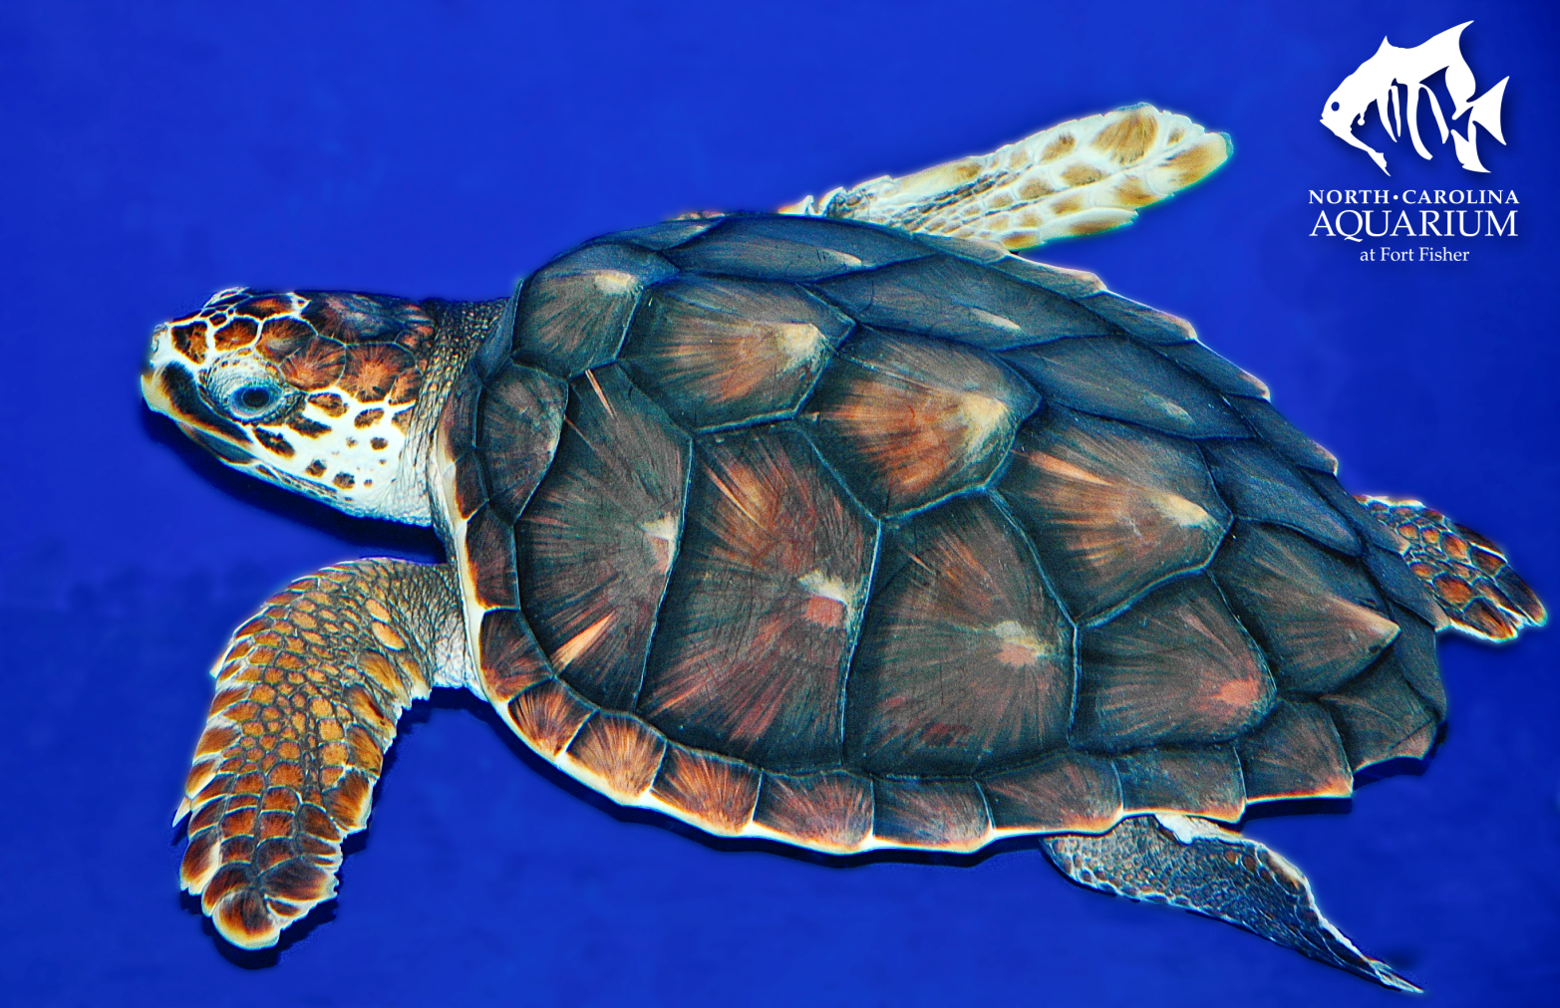
Turtle 1

Slide 4
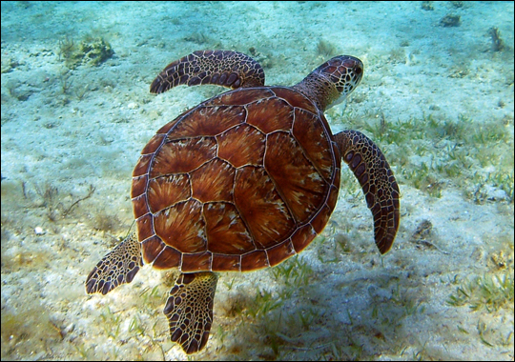
TURTLE 2

Slide 5
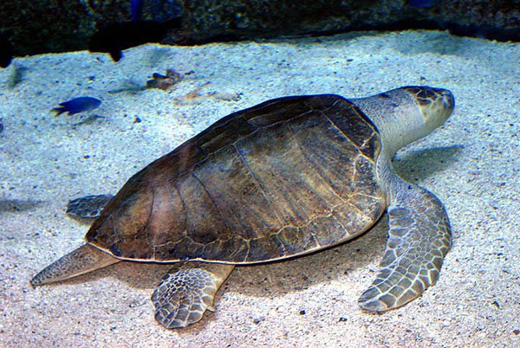
TURTLE 3

Slide 6
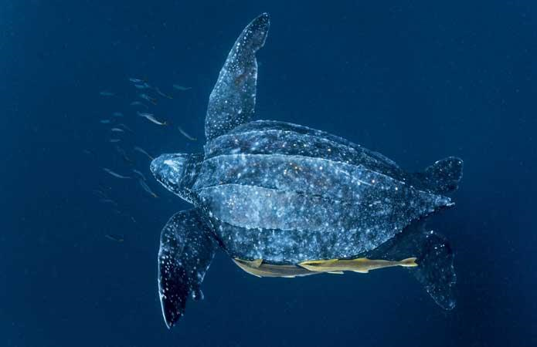
TURTLE 4

Slide 7
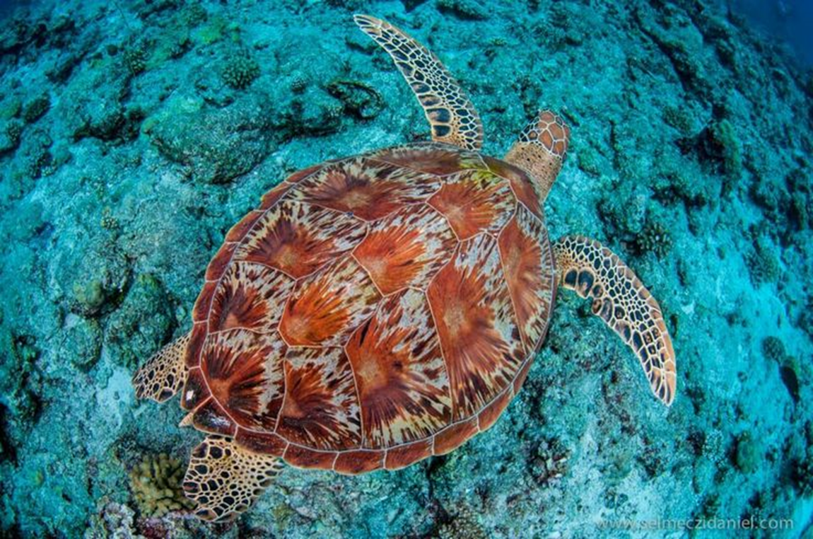
TURTLE 5

Slide 8
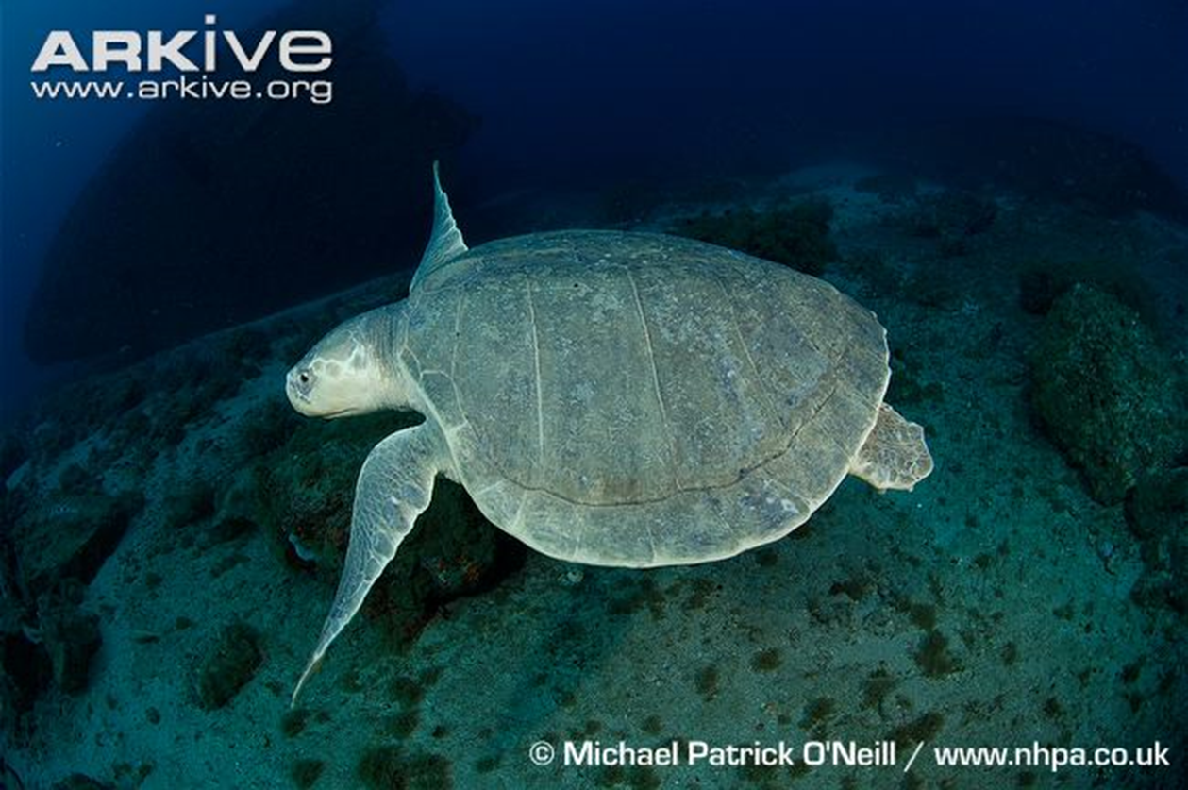
TURTLE 6

Slide 9
Round 2
NOW, IDENTIFY THE TURTLE BY USING THE BEAK OF THE SEA TURTLE

Slide 10
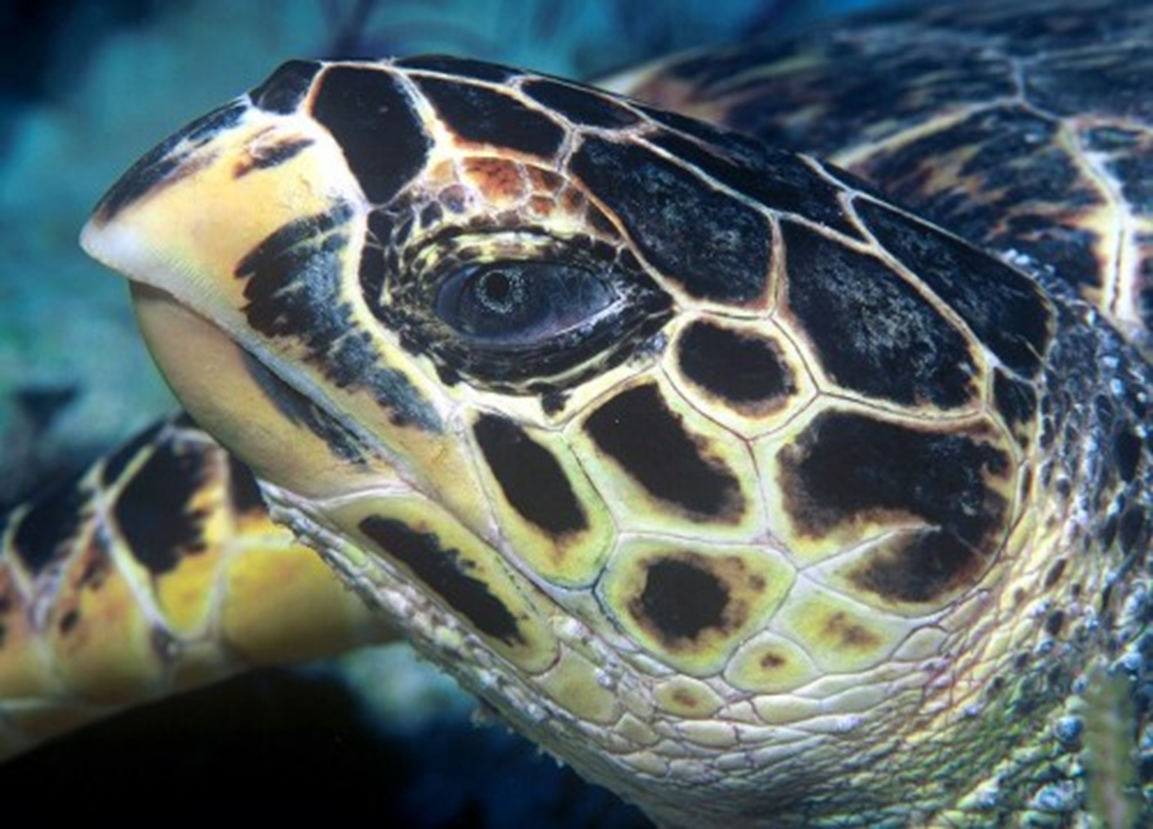
TURTLE A

Slide 11
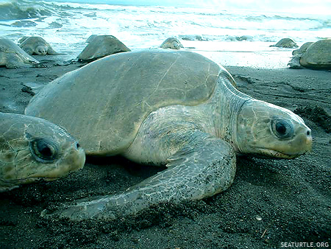
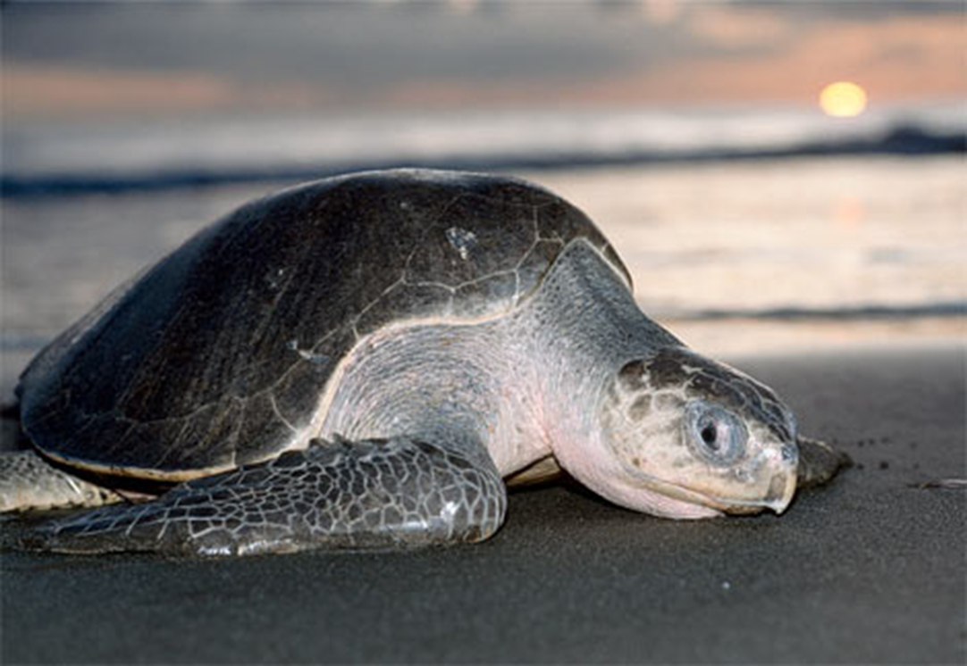
TURTLE B

Slide 12
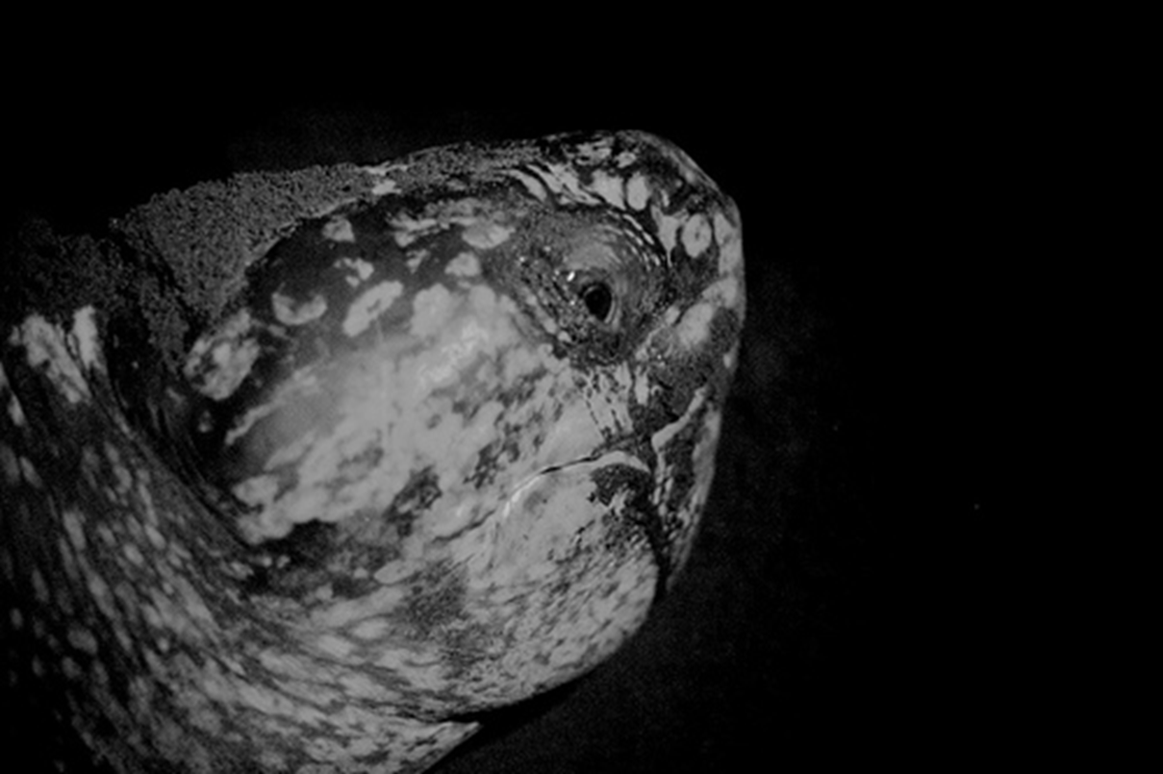
Turtle C

Slide 13
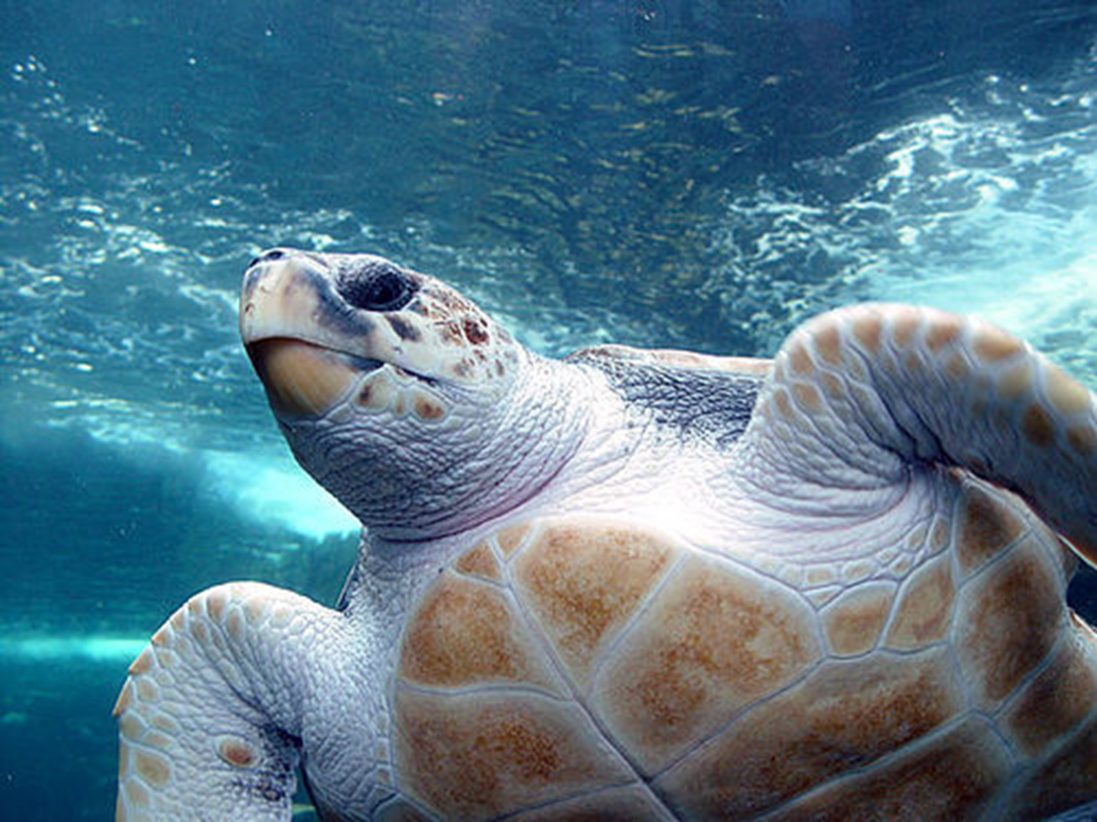
Turtle D

Slide 14
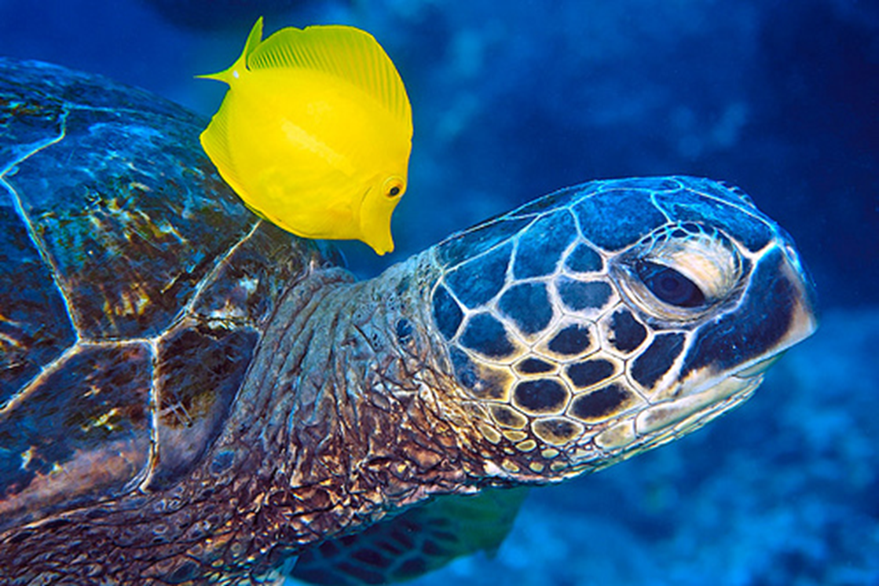
TURTLE E

Slide 15
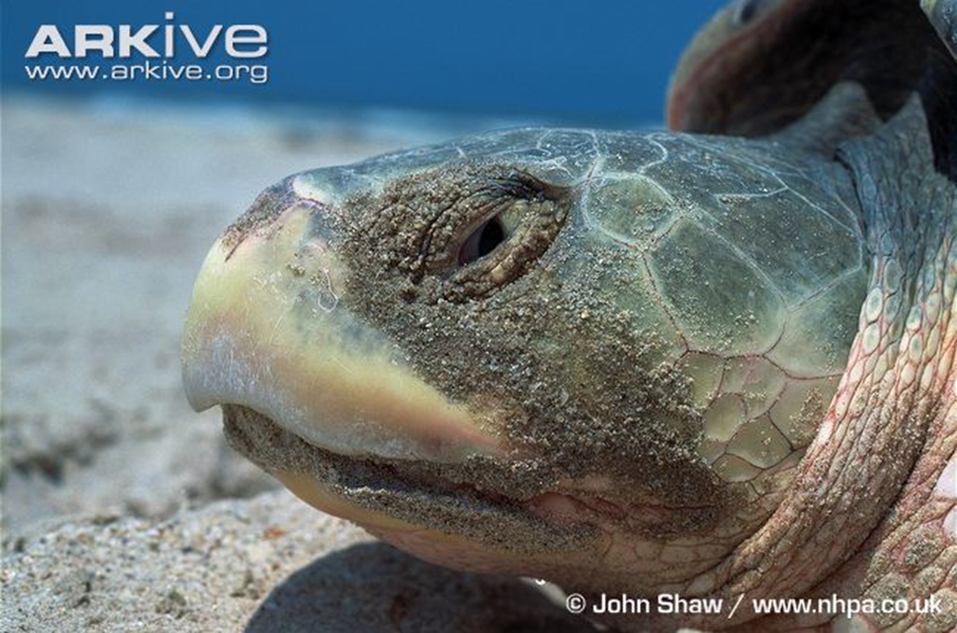
TURTLE F

Slide 16
QUESTIONS- place answers on the bottom of your sheet
1. What two structures were used to determine the species of turtle?
2. Which turtle was the hardest to identify?
3. Which turtle species is the most distinct?
4. What characteristics do you use when looking at the carapace?
5. Why are sea turtles endangered? List 2 reasons.

