Slide 1
Chapter 3
Marine Environments

Slide 2
Marine Life Zones
Life zones are regions that contain organisms that interact with one another and their environment.
In all marine environments the living (biotic) things interact with the nonliving (abiotic) things like water chemistry, light, temperature, salinity, and water pressure.

Slide 3
Life Zones: The Intertidal Zone
This is the area located between the high and low tide.
High tide is often marked by a strandline of debris and seaweed.
Organisms in the intertidal are adapted to being totally submerged part of the day to being completely dry other parts of the day.

Slide 4
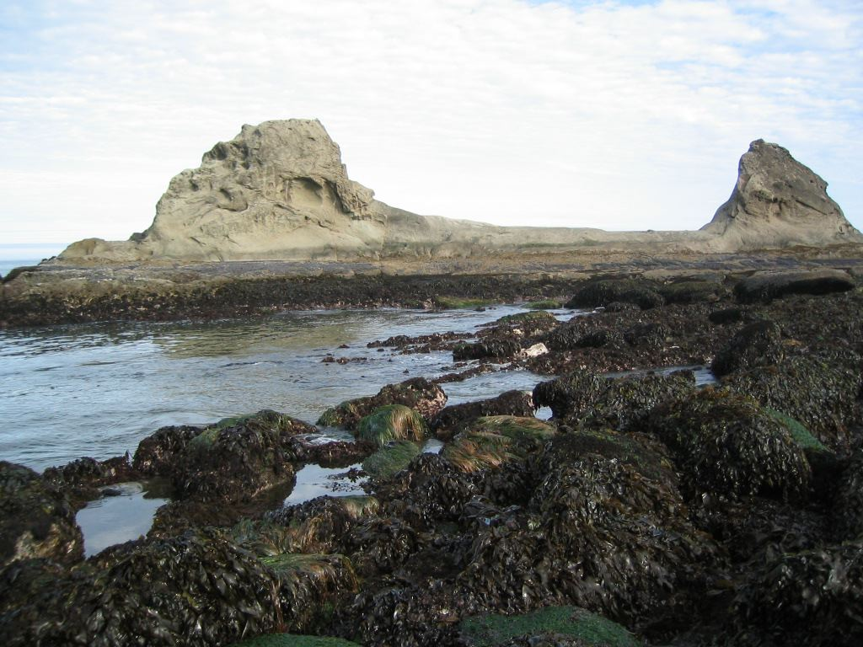

Slide 5
Life Zone: Supratidal Zone
This is the area above the high tide line.
In this zone, there are often grasses, shrubs and trees that cannot grow further down due to too much salt spray.

Slide 6
Life Zones: The Subtidal Zone
This zone is below the low tide line - it is completely underwater.
It has heavy wave impact and turbulence.
Animals are adapted to cling to surfaces: sponges bore into rocks, seastars use tubefeet to suction to rocks, mussels have byssal threads to stick to rocks and barnacles secrete cement to stick to rocks.

Slide 7
The Subtidal Zone

Slide 8
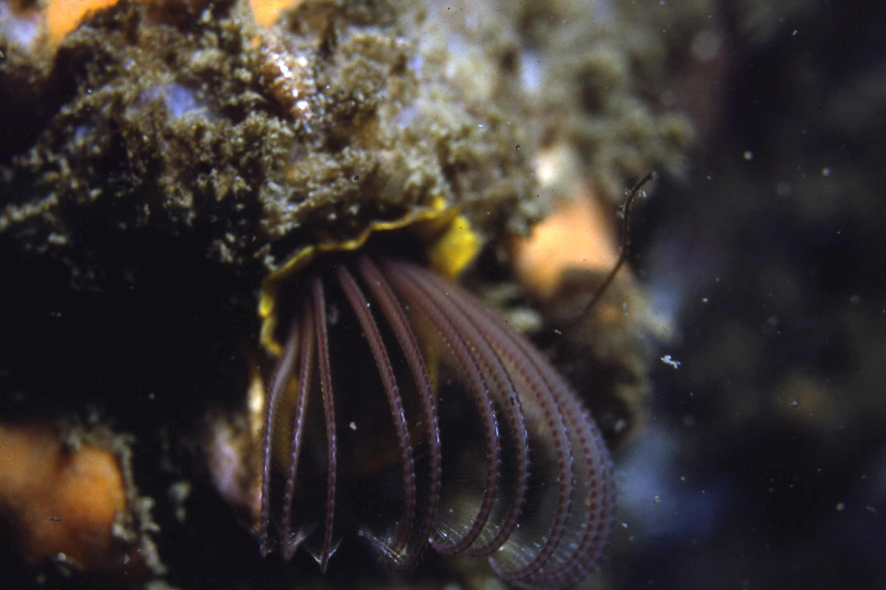

Slide 9
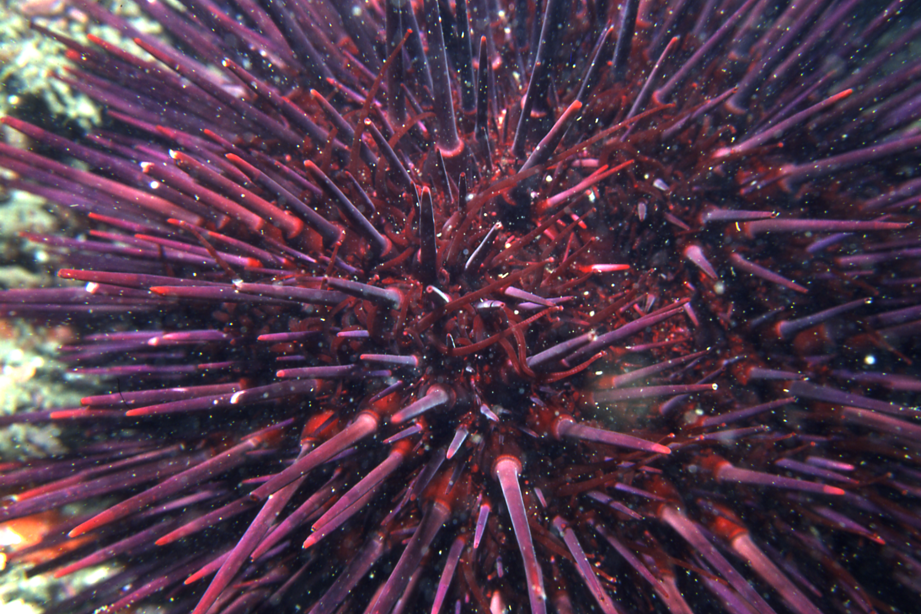

Slide 10
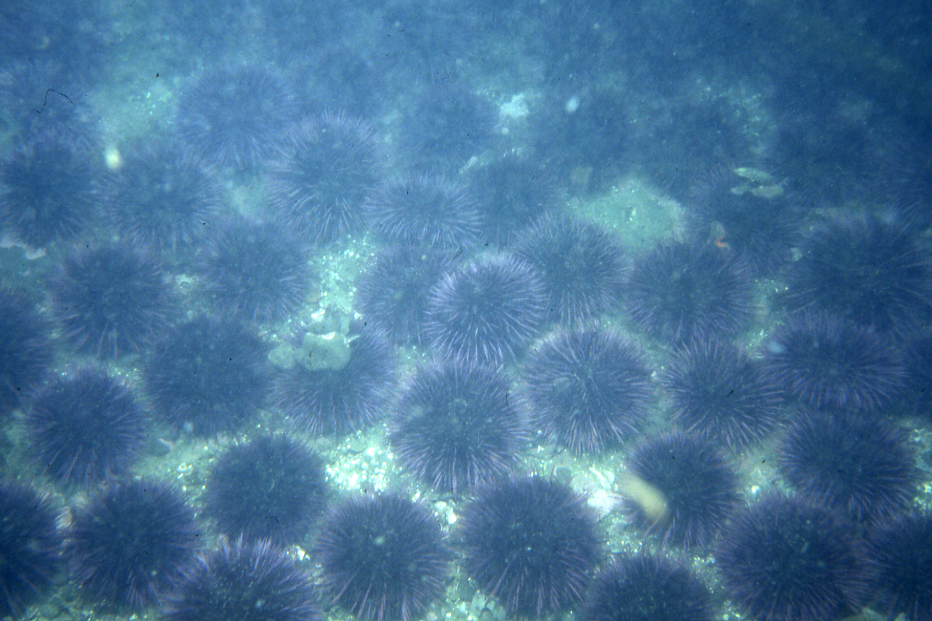

Slide 11
Life Zones: The Pelagic Zone
This is the largest zone in the ocean. It covers the entire ocean above the sea bottom.
Large schools of fish and pods of marine mammals swim here freely.
It includes the neretic zone and the oceanic zone.

Slide 12
Whales in the Pelagic zone

Slide 13
Life Zones: The Neritic Zone
This is the zone beyond the subtidal zone.
It lies above the continental shelf, the shallow part of the seafloor that adjoins continents.
It is a productive area due to runoff from rivers and land that provides nutrients for the phytoplankton. Most fisheries are located here.

Slide 14
The Corwith Cramer over the Neretic Zone (SEA program)

Slide 15
Life Zones: The Oceanic Zone
This is the zone that extends beyond the neretic zone and includes most of the open ocean.
The upper part receives light (the photic zone) and the lower part is dark (the aphotic zone).
Deepsea fish and anglers have special adaptations to catch food in the dark zones - including large mouths to catch scraps that fall from shallow water or lights that glow and attract prey.

Slide 16
Heading out to the oceanic zone……

Slide 17
Sampling for plankton in the photic zone

Slide 18
Life Zones: The Benthic Zone
This is the bottom of the ocean and includes the entire ocean floor.
Organisms that inhabit the benthic zone are called the benthos and include many fish and invertebrates like worms, clams, snails, slugs, sea anemones and sea stars.
We now think that the deep sea benthos has tremendous diversity - much more than the number of invertebrates that live on land.

Slide 19
The Benthic zone

Slide 20
The Environments: the Sandy Beaches
This is one most of us have visited!
The sand with its loose, shifting sediment makes it a harsh place to live.
The beach consists of a surf zone that is home to mole crabs and surf clams - life here is like always being in a storm.
Silversides live in the oxygenated surf zone and their predators (striped bass, bluefish) swim in from deeper waters to prey on them.

Slide 21
Waikiki Beach, Oahu, Hawaii

Slide 22
Snorkeling over the subtidal zone on Waikiki Beach with Diamond Head in the back

Slide 23
The Black Sand Beaches on the Hana Highway, Maui, Hawaii

Slide 24
The Beaches near JFK airport, NY

Slide 25
Skimboarding along the beaches in Oregon

Slide 26
Bastendorf Beach, Coos Bay, Oregon

Slide 27
Alice in Wonderland Beach, Bonaire

Slide 28
The Sand Dunes - an extension of the beach community - Oregon

Slide 29
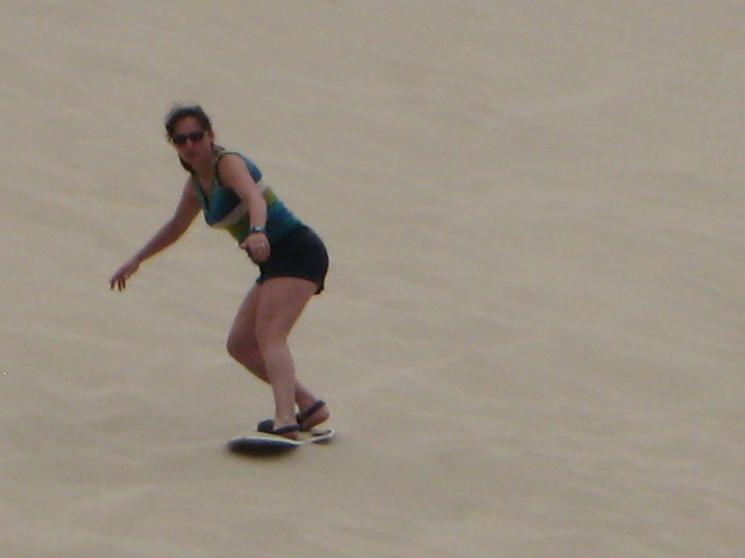
More dunes… Oregon National Dunes Recreation Area

Slide 30
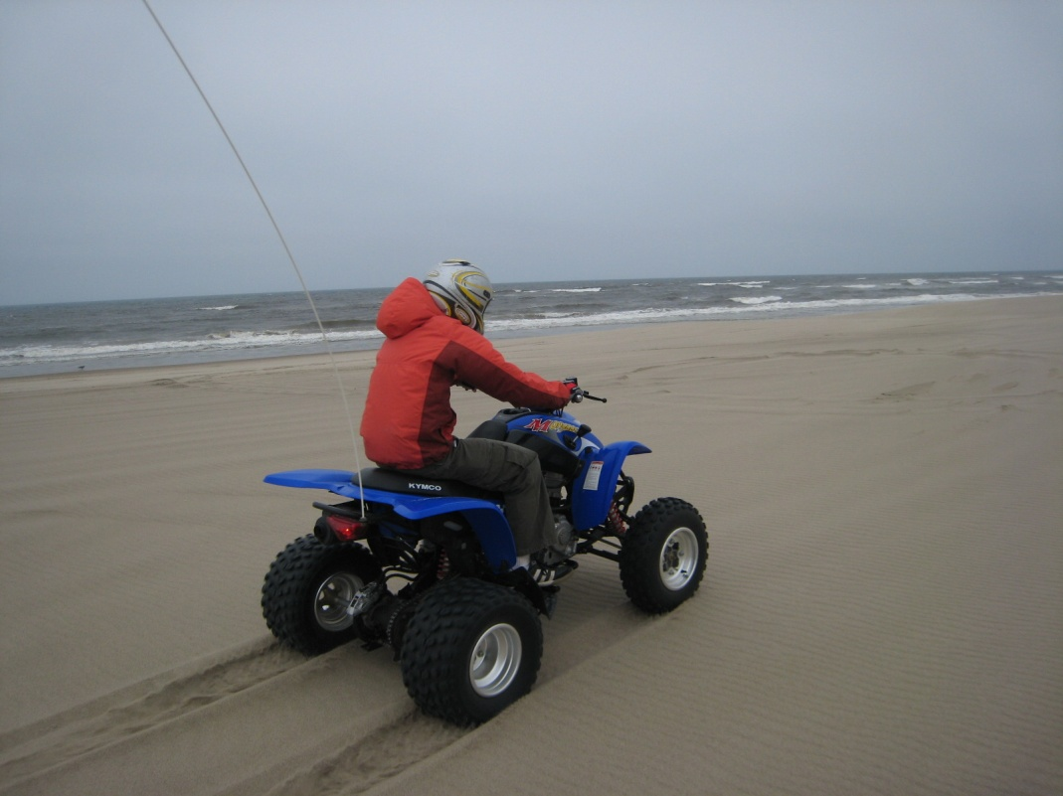
ATVs on the Dune help rip up introduced European beach grass

Slide 31
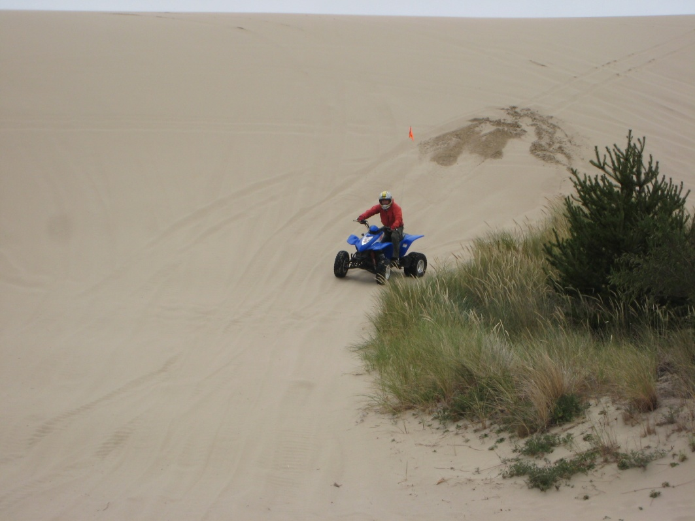
Doing our part to save the Dunes

Slide 32
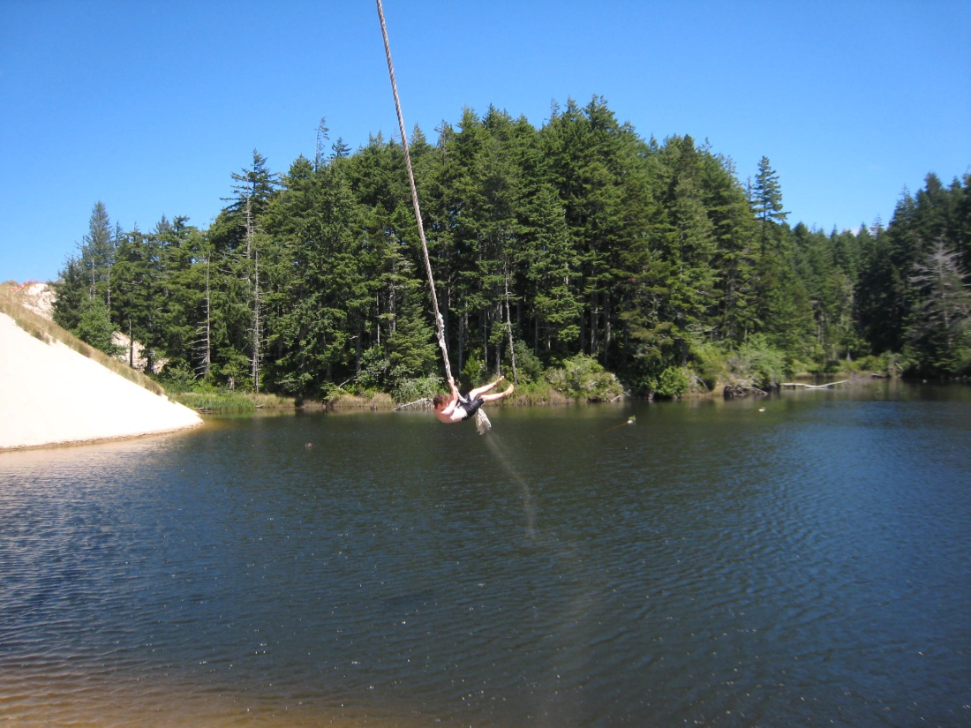
Dunes cascade into freshwater lakes away from the coast

Slide 33
The Environments: The Rocky Coast
Many coastal states have shores composed of solid rock.
Rocks can provide a surface for organisms to attach themselves.
Seaweeds and seagrasses cling to rocks.
Zonation is very strong on the rocky shores and different organisms are found in different zones

Slide 34
Rocky shores along San Juan Islands, Washington (kelp forest in subtidal zone)

Slide 35
San Juan Island, Washington

Slide 36
The Environments: The Rocky Coast
The upper intertidal is home to bacteria, snails, limpets, and barnacles.
The mid-intertidal zone is largely occupied by barnacles, mussels and seaweeds. Whelks often prey on barnacles here. Sea stars and tautogs often come in and prey on the molluscs.
The lower intertidal is dominated by seaweeds and tide pools.
The subtidal zone is home to lobsters, crabs, and predatory fish - best observed while snorkeling.

Slide 37
Orca whale off the rocky shores of the San Juan Islands

Slide 38
Tide Pools in the lower intertidal, Oregon

Slide 39
Sea urchin pits in the uplifted sandstone along the rocky shore of Cape Arago, Oregon

Slide 40
The entrance to Sea Lion Caves, Florence, Oregon

Slide 41
Inside Sea Lion Caves where hundreds of California and Stellar sea lions congregate

Slide 42
Face Rock, Bandon, Oregon

Slide 43
Tufted puffin along the Rocky shores of the Pacific Northwest

Slide 44
Rocky shores of Southern Oregon

Slide 45
Resistant rock nodules along Shore Acres, Oregon

Slide 46
The coastal trail, Cape Arago, Oregon

Slide 47
Subtidal zone along rocky shores in Oregon- seastars everywhere

Slide 48
Collecting mussels along the intertidal zone, Lighthouse Beach, Oregon

Slide 49
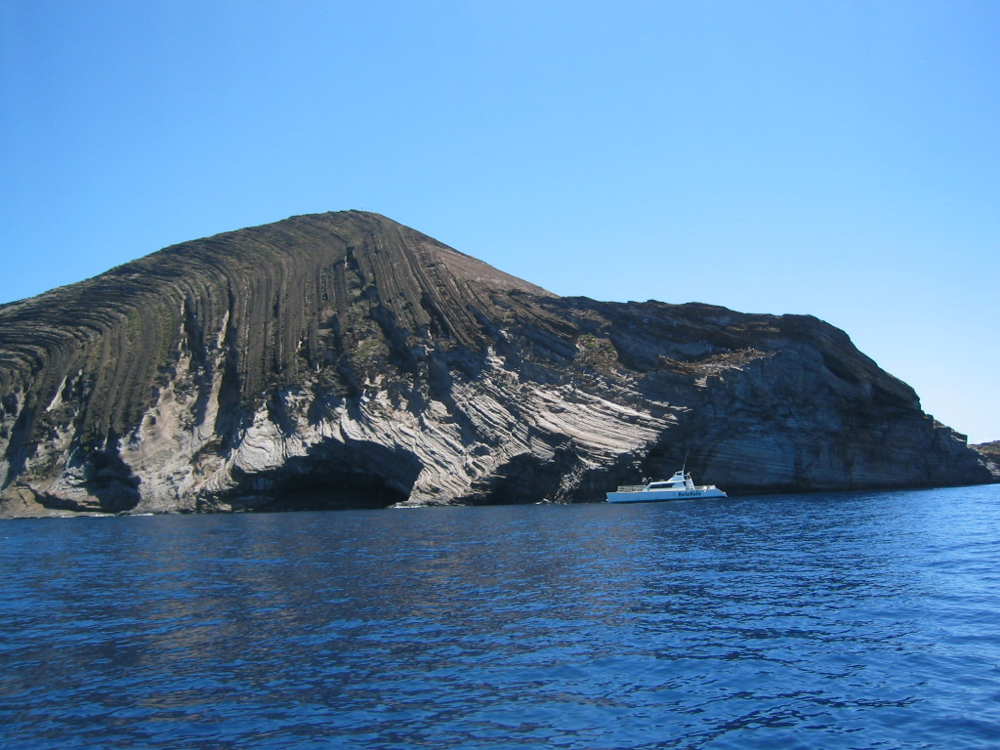
Ni’ihau and Lahaina, off the coast of Kauia, Hawaii - volcanic rocky shores

Slide 50
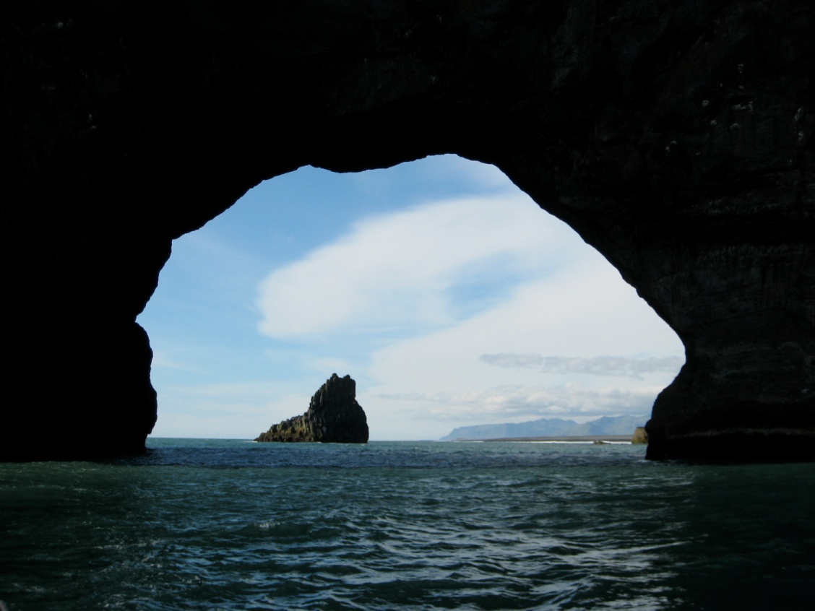
Volcanic Rocky shores, Iceland

Slide 51
The Environments: The Estuary
The estuary is an area where freshwater rivers drain into the oceans.
The water is often brackish here.
Estuaries are calm, nutrient-rich areas that are natural sanctuaries for a wide variety of organisms of all or part of their lives.
Estuaries are made up of the following environments…..

Slide 52
The Environments: The Estuary - Salt marshes
Salt marshes are dominated by grasses that grow in shallow water (wetlands).
The dominant grass is Spartina grass that is resistant to salt - the leaves secrete salt crystals.
The dead grass (detritus) provides lots of nutrients for the estuary.
Animals include ribbed mussels, fiddler crabs, hermit crabs, baby fish (it is a nursery ground for fish). Many birds depend on the salt marshes for food.

Slide 53
Salt marsh - Metcalf marsh, Charleston, Oregon

Slide 54
Hidden Creek salt marsh, South slough, Oregon

Slide 55
South Slough National Estuarine Research Reserve

Slide 56
The Environments: The Estuary - Mudflats
Part of the estuary has dark, muddy sand and no marsh grass - these are the mudflat communities.
The mudflat has little aeration (flushing is minimal) and detritus accumulates. The sediment is often anaerobic and smells like rotten eggs (H2S).
The mudflat is home to mudsnails that scavenge for food, clams that siphon plankton from the water, and many worms.

Slide 57
The Portside Mudflats, Charleston, Oregon

Slide 58
Mudflats - clamming for dinner

Slide 59
The Environments: The Estuary - The Mangroves
In tropical regions, such as Florida, the shores and bays are covered with mangrove communities.
The red mangrove grows in the water and has arching prop roots that anchor the trees. The black and white mangroves grow higher in the intertidal zone.
Debris gets trapped in mangroves and dead leaves from the mangrove trees provide nutrients for plankton.
Mangroves are home to diverse communities, and also protect the shoreline from erosion.
Mangroves absorb the impact of storms.

Slide 60
Kayaking in the Mangroves, Key Largo, Florida

Slide 61
Sunrise on Short Key, Florida - Mangroves and pines

Slide 62
American crocodile near the channel leading to the Mangrove Swamps

Slide 63
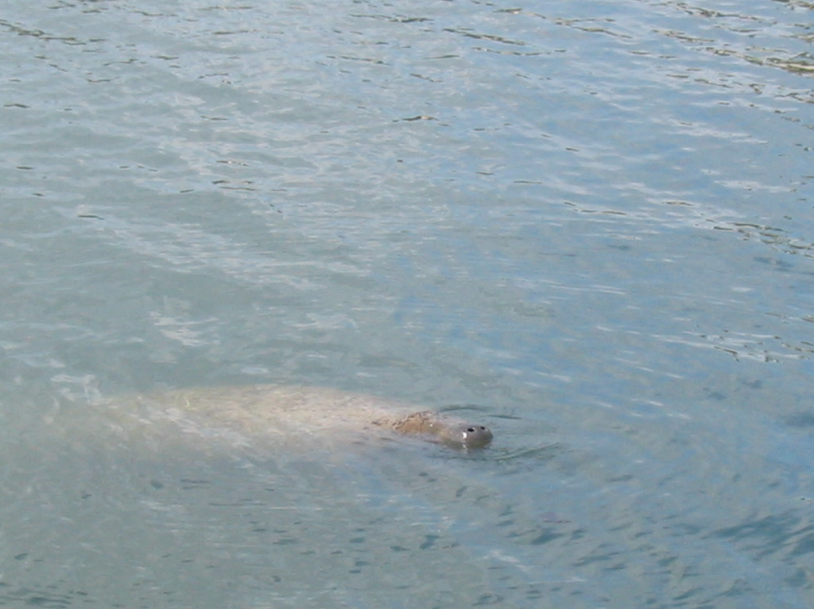
Manatee - cruising through the mangrove swamps, Key Largo, Fl

Slide 64
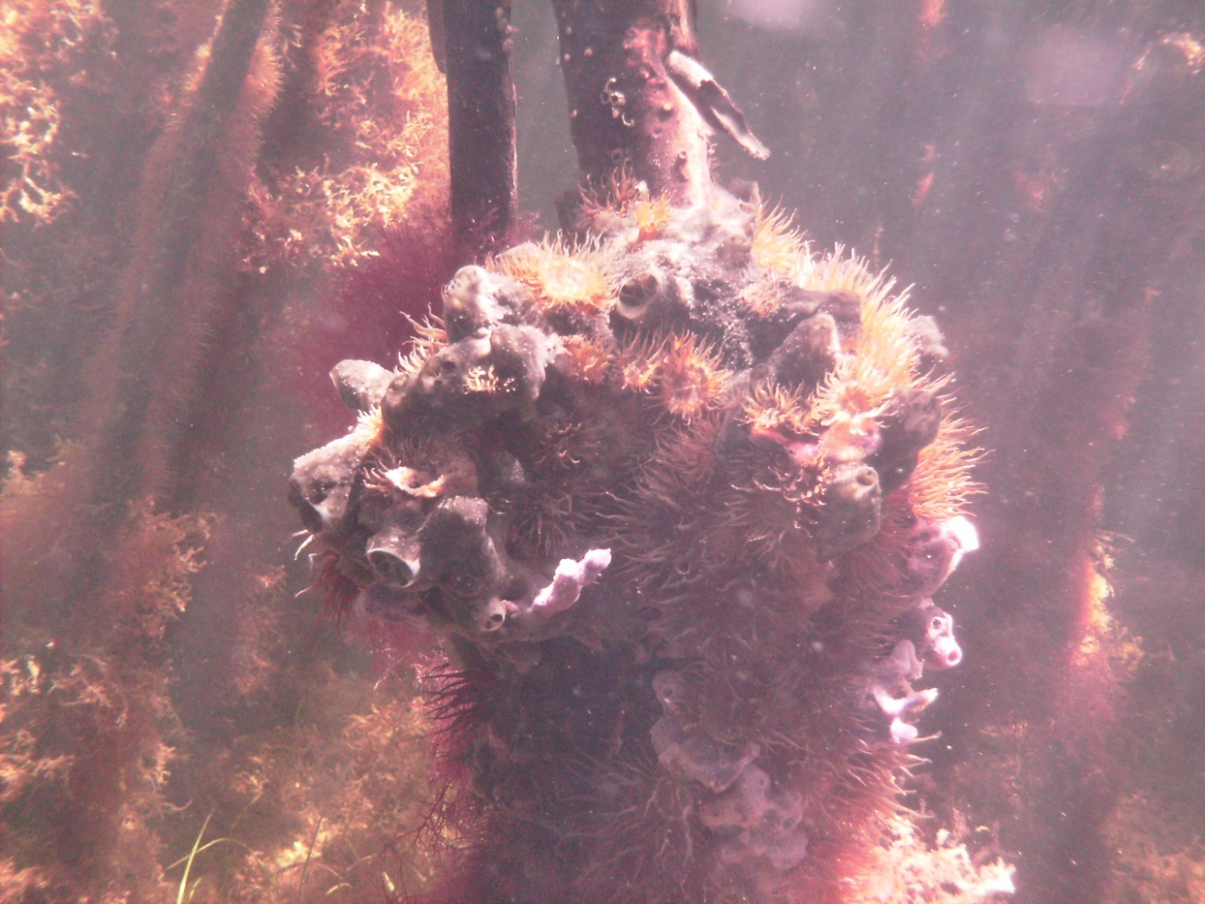
Mangrove prop roots underwater - covered with life

Slide 65
The Environments: The Estuary - The Seagrass beds
Seagrass beds are incredibly productive areas.
They consist of one of the only flowering plants that can live submerged in the ocean.
They are nursery grounds for many fish and home to a great diversity of animals.

Slide 66
Studying Seagrass beds at Sunset Cove, Key Largo, Fl

Slide 67
Turtle Grass - a favorite food of sea turtles and manatees

Slide 68
A Blue Crab cruising around in the seagrass beds

Slide 69
Seining for fish in the eelgrass beds in the South Slough estuary

Slide 70
The Environments: The Coral Reef Environment
The coral reef is simply the most beautiful and productive of all marine habitats!
Coral reefs are incredibly diverse habitats built by coral animals.
The coral polyp of stony corals secrete calcium carbonate and build the reefs. The energy it takes to do this is obtained via their tentacles and the zooxanthellae that live inside them.
Corals require clear, warm water to grow.

Slide 71
The Environments: The Coral Reef Environment
Coral reef inhabitants are incredibly colorful and have many unique adaptations for life on the reef.
Animals either have hiding places, use camouflage, swim in schools, possess color contrast (patterns) or disruptive coloration to prevent predation.

Slide 72
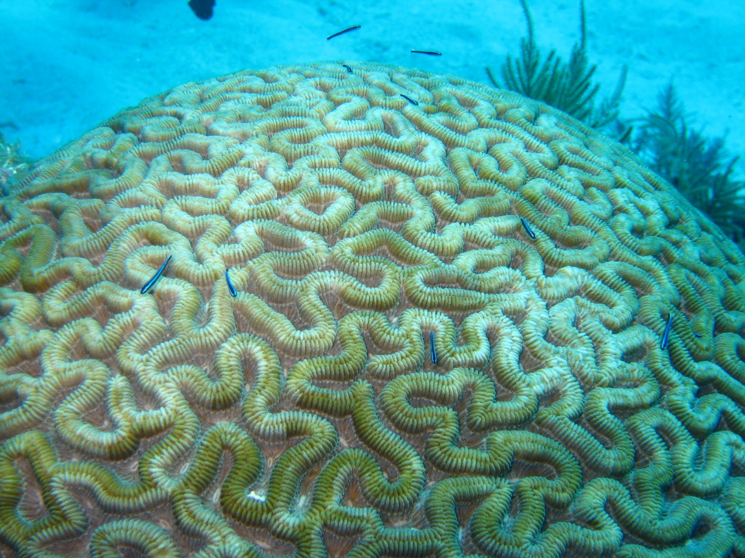
Exploring the coral reefs off Key Largo, Florida

Slide 73
Elkhorn coral - Key Largo, FL - struggling for survival

Slide 74
Spotted Moray Eel under the coral

Slide 75
Coral with Christmas Tree Worms

Slide 76
French Angelfish under a coral ledge

Slide 77
Coral Propagation On Big Pine Key, Florida

Slide 78
Parrotfish with a remora in Key Largo, Fl

Slide 79
Creole Wrasse, Bonaire

Slide 80
Bar Jacks - with different coloration

Slide 81
Frog fish, Bonaire - great camouflage

